Slide 1
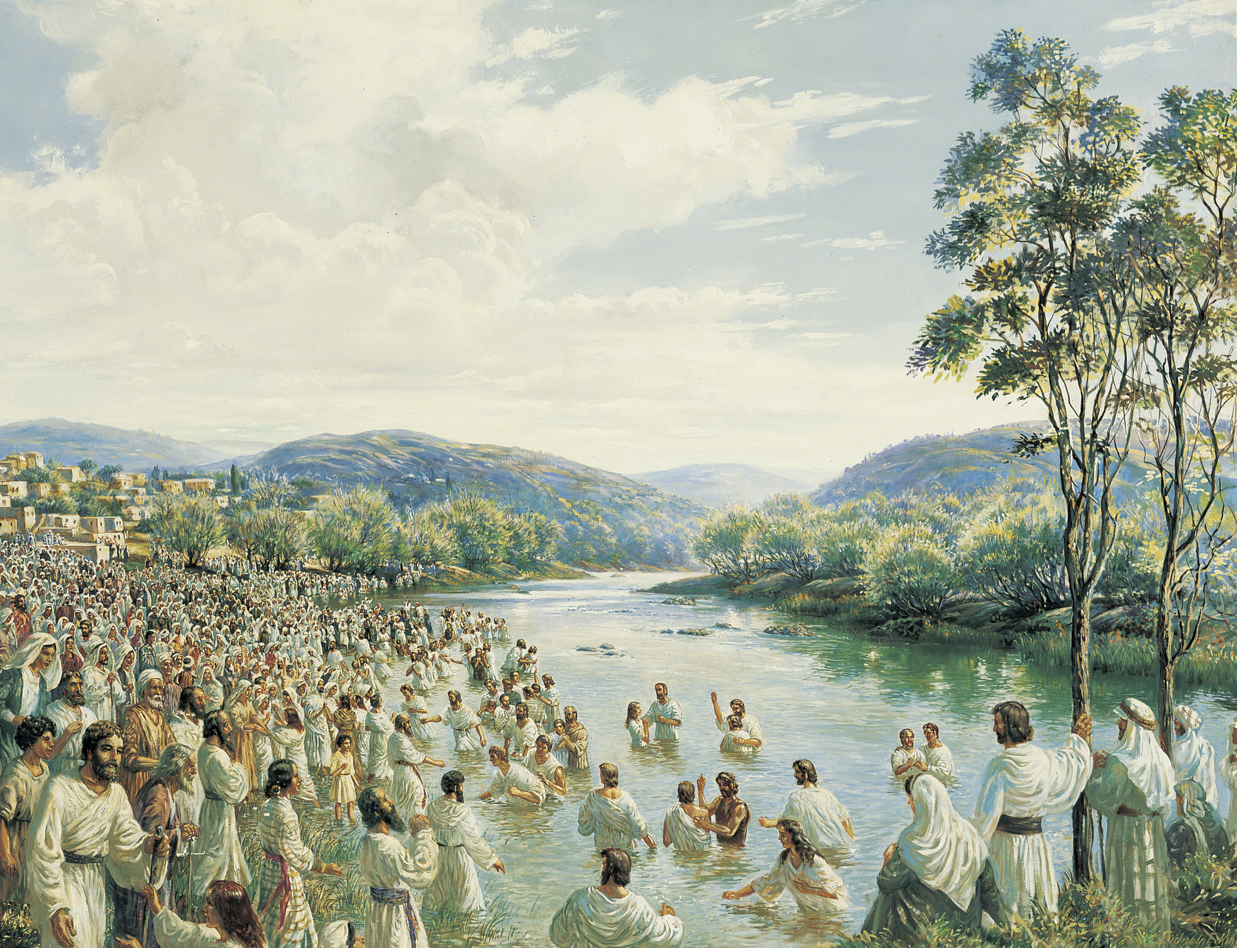
CHRIST THE ROCK CONGREGATION
SUNDAY AUGUST 20TH 2023
Sermon BY Marc Simeon
THE SECRETS OF THE PRIMITIVE CHURCH
THE PRIMITIVE CHURCH: A MODEL TO FOLLOW

Slide 2
Acts 2:41-47
41 Then those who gladly received his word were baptized; and that day about three thousand souls were added to them.
42 ¶ And they continued steadfastly in the apostles' doctrine and fellowship, in the breaking of bread, and in prayers.

Slide 3
43 Then fear came upon every soul, and many wonders and signs were done through the apostles.
44 Now all who believed were together, and had all things in common,
45 and sold their possessions and goods, and divided them among all, as anyone had need.

Slide 4
46 So continuing daily with one accord in the temple, and breaking bread from house to house, they ate their food with gladness and simplicity of heart,
47 praising God and having favor with all the people. And the Lord added to the church daily those who were being saved.

Slide 5
INTRODUCTION
Nowadays, Christians fantasize a lot about the primitive Church.
Many churches and denominations are named “Primitive Church”.
People emphasize on the intensity of the power of the Holy Ghost that was bestowed upon the first church.

Slide 6
People reflect on how the first Church of the Apostles was so inclined to the leading of the Holy Spirit.
We talk about how spiritual the first Church was.
People talk about the togetherness and the liberalities of the first Christians.

Slide 7
We Sometimes fail to see the mechanism behind the huge success that the first church has experienced.
Often times, we fail to see the hard labor that they had to put in place in order to maintain that blessing.

Slide 8
We here at CTRC, are mandated to take an inside look at the first church in order to unearth some of the secrets for its amazing accomplishments.

Slide 9
We will look at some of the challenges they faced and how they overcame them.
We will see how they were able to pass on such a great legacy to the many churches that were going to pattern after them.

Slide 10
CREDIT IS DUE TO THE FIRST APOSTLES
Credit is due to the first Apostles because they were forced to begin a journey that no one else has ever taken.
They were handed no manual on how to lead a church.
No handbook was given them about church growth.

Slide 11
None of them had had any previous experiences to prepare them for such an undertaking.
They spent 3 years with the Master with no church assembly.
What was beginning to look like a church, Jesus had scattered them with one sermon.

Slide 12
The Apostles seemed more as a group of loners who were hanging around with Jesus.
None of them had any serious management skills
No Phd (s) in their midst.
They did some mission work when the Master was alive and that was all.

Slide 13
They had done some baptizing and some casting-out of demons, but nothing notorious.
The whole focus was on Jesus.
They could not even grasp any strong teaching although they spent 3 years at the feet of Master Jesus.

Slide 14
They were often rebuked by Jesus for their little faith and their lack of understanding.
No one would phantom the idea that this challenged and underprepared group of disciples would be credited to turn the world upside down with the gospel of Jesus Christ. But they did!

Slide 15
As soon that the Master was taken away from them, they knew that they had some maturing to do.
They had to learn to follow direction.
The first one was to go to Jerusalem and wait.

Slide 16
You ask someone like Peter to go and wait, it’s like putting a set of handcuffs in his hands.
Peter had now 119 people to give instructions to.

Slide 17
Before The Holy Spirit even made a touchdown, Peter was already busy casting lot to replace Judas.
They did one thing right: Acts 1:14 tells us :

Slide 18
Ac 1:14 These all continued with one accord in prayer and supplication, with the women and Mary the mother of Jesus, and with His brothers. (NKJV)
The first group of Christians were :
  All in one place
  All in one accord
  All in prayer

Slide 19
There was no gender discrimination
There was no social status classifications among them.
50 days after the Resurrection, 10 days after the Ascension to the day of Pentecost, they were still at the same place doing the same thing

Slide 20
Acts 2:1-4 tells us of the scene.
Ac 2:1 ¶ When the Day of Pentecost had fully come, they were all with one accord in one place.
2 And suddenly there came a sound from heaven, as of a rushing mighty wind, and it filled the whole house where they were sitting.

Slide 21
3 Then there appeared to them divided tongues, as of fire, and one sat upon each of them.
4 And they were all filled with the Holy Spirit and began to speak with other tongues, as the Spirit gave them utterance.

Slide 22
All in one place
All in one accord
All praying in expectation of the coming of the Holy Spirit
All were filled with the Holy Spirit
All were speaking in tongues by the utterance of the Holy Spirit.

Slide 23
All means: (men, women, children, young, adults, apostles, and disciples
All took a halt in their manifestations and remained silent to allow Peter to speak to the crowd.

Slide 24
Ac 2:14 ¶ But Peter, standing up with the eleven, raised his voice and said to them, "Men of Judea and all who dwell in Jerusalem, let this be known to you, and heed my words.
Three things to underline
All the 120 disciples accepted the leadership of Peter.

Slide 25
All the 120 disciples accepted the choice of the Holy Spirit for Peter to be the spoke person.
Jesus’ immediate family did not interpose their hierarchy over the church since they were blood relatives of Jesus.

Slide 26
Some develop a sense of pride because they are being used by God in a significant way.
Some refuse to yield under the authority of spiritual leaders because they feel that they are in the same footing with everyone else since they are being used by God as well.

Slide 27
The secret of the primitive church started as follow
  Togetherness, brotherly love,
  mutual respect, faith,
  generosity, obedience,
  humility, worship,
  steadfastness, prayer,
  teaching of the Word, and fear of God.

Slide 28
Acts 2:42-47
42 ¶ And they continued steadfastly in the apostles' doctrine and fellowship, in the breaking of bread, and in prayers.
43 Then fear came upon every soul, and many wonders and signs were done through the apostles.

Slide 29
44 Now all who believed were together, and had all things in common,
45 and sold their possessions and goods, and divided them among all, as anyone had need.

Slide 30
46 So continuing daily with one accord in the temple, and breaking bread from house to house, they ate their food with gladness and simplicity of heart,
47 praising God and having favor with all the people. And the Lord added to the church daily those who were being saved.

Slide 31
Contrarily to contemporary churches, the success of the first church was not mechanical.
  Healing, deliverance, miracles = crowd.
  Live worship with professional singers and musicians = crowd
  Benevolence, charity, social assistance = crowd

Slide 32
The church of the first Apostles had the following:
  Love, faith, benevolence, perseverance, togetherness, respect for the governing body,
Consequently, the Holy Spirit was able to operate among them freely and happily.

Slide 33
Acts 2:47b And the Lord added to the church daily those who were being saved.
The numerical growth of the Primitive Church was evident for everyone to see.
From 120 in the Upper Room to 2000 at Pentecost, to 3000 shortly after; and from 5000 to the multitude.

Slide 34
If you want to recreate the first church :
  Learn how they got there
  Their success was not in the number of their parishioners
  Their growth was a result of everything going right at the same time.

Slide 35
  You cannot have indifferences among you and expect growth
  You cannot have lack of respect for one another and expect growth
  You cannot have envy and jealousy and expect growth
  You cannot be a prayerless church and expect growth

Slide 36
  You cannot have all sorts of abnormalities in the church and expect growth.
  You cannot nourish sin in the church and expect growth.
  You cannot have lack of reverence for God and his ministers and expect growth.

Slide 37
CONCLUSION
As a pastor, nothing would please me more to see our church functioning in the pattern of the first Church.
I like all of it that they were experiencing.
I wish I could locate a congregation that replicates the Primitive Church in all aspects.

Slide 38
I realize that it took a collective effort for them to get there.
I also realize that they had their set of challenges and carnalities among them.
I realize that they were not perfect, but they worked hard at it to preserve the presence of God in their midst.

Slide 39
I believe that God is still willing to bless any congregation who wants to put the effort to walk in holiness and brotherly love.
We need the missing elements to convince the world of the Gospel of Christ.
We need the kononia (fellowship); we need the zeal, we need the same prayer life,; we need the kind of fear of the Lord that they’ve had.

Slide 40
We need the same power that they’ve had.
We need the same hunger for God that they’ve had.
God will not fail to add his share of blessing to bring back the same fire that they’ve had if we act accordingly.

Slide 41
If we really wish to pattern Christ The Rock Congregation after the Primitive Church, then, all of us must be willing and ready to submit ourselves to the same discipline as they did.

Slide 42
Let’s work on making our church an emblem for all churches to follow in all generations to come.
And same will be said on account of our church 2000 years from now.
Amen

