Slide 1
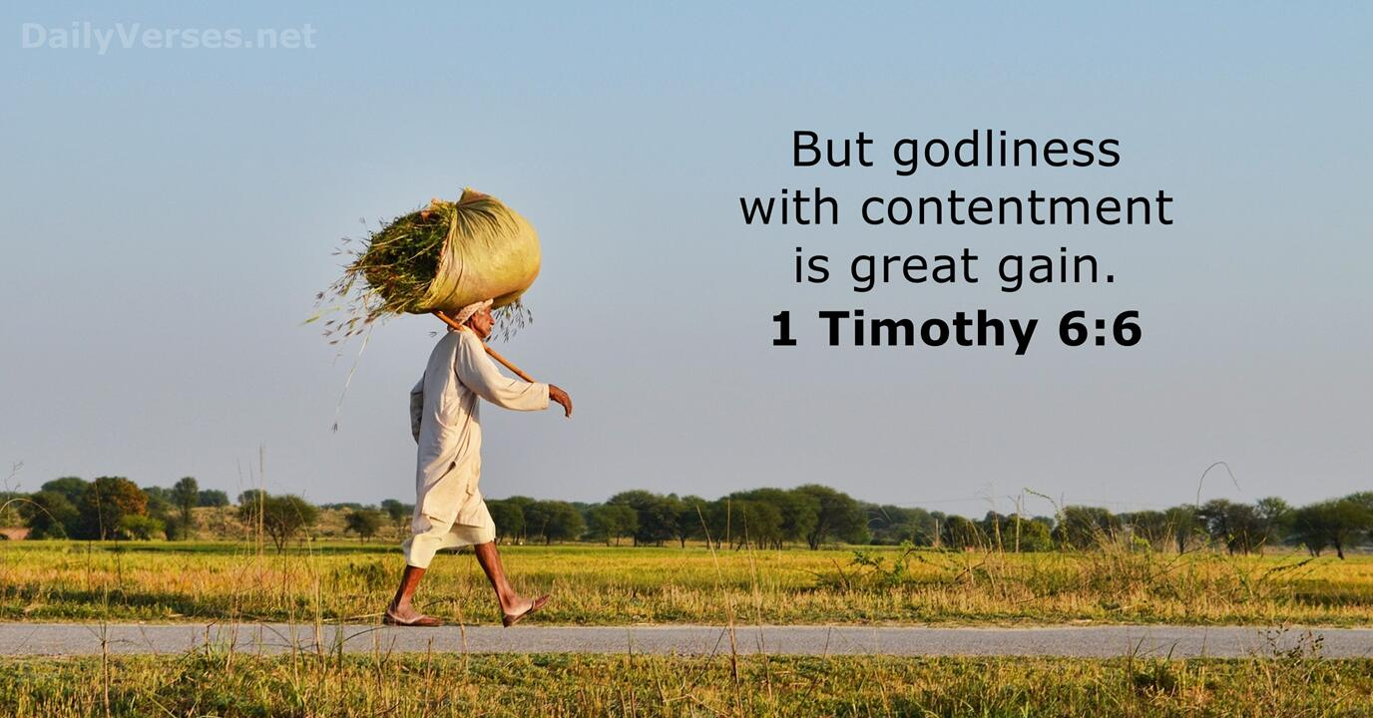
CHRIST THE ROCK CONGREGATION
SUNDAY AUGUST 27TH 2023
Sermon BY Marc Simeon
LEARNING TO BE SATISFIED WITH WHAT GOD GIVES YOU

Slide 2
1Tim 6:6-12
1Ti 6:6 ¶ Now godliness with contentment is great gain.
7 For we brought nothing into this world, and it is certain we can carry nothing out.
8 And having food and clothing, with these we shall be content.

Slide 3
9 But those who desire to be rich fall into temptation and a snare, and into many foolish and harmful lusts which drown men in destruction and perdition.
10 For the love of money is a root of all kinds of evil, for which some have strayed from the faith in their greediness, and pierced themselves through with many sorrows.

Slide 4
11 But you, O man of God, flee these things and pursue righteousness, godliness, faith, love, patience, gentleness.
12 Fight the good fight of faith, lay hold on eternal life, to which you were also called and have confessed the good confession in the presence of many witnesses.

Slide 5
INTRODUCTION
Our world is run by greed and an insatiable thirst for dominance.
Our generation suffers the disease of dissatisfaction.
Since most people are not connected with God, they are left with vacuum that nothing in this life can substitute for it.

Slide 6
Some try to accumulate as much wealth as they can only to widen the gulf within them.
The dream house on the hill or by the ocean could not do it for them.
The many degrees from the learning institutions could not do it for them.

Slide 7
Reaching the pinnacle in the social ladder also fails to fill the gap.
The many luxurious cars and collectible items could not do it for them.
King Salomon, an avid thrill seeker tried it all to no avail. He saw them as vanity.

Slide 8
The vicious cycle is that the next adventures keep on promising falsely that you will find that wholeness if you give them a try.
Some are on their 5th divorce because they cannot be contented.
Some have from country to country in search for that click.

Slide 9
Many develop compulsive behaviors in search for contentment resulting in all sorts of addiction.
Gambling, Eating, Drinking, Shopping, Sexual pleasure, Exercising and Sleeping just to name a few can quickly get out of hand because of the inability for some to be contented.

Slide 10
It’s as if one keeps on eating and never feels full.
The Bible has a simple solution for those who wish to live a fulfilled and contented life.
Today in the light of the Bible, we will consider the effect of contentment.

Slide 11
LEARNING TO BE CONTENTED IN LIFE
1Ti 6:6 ¶ Now godliness with contentment is great gain. (NKJV)
Example of the fisherman and the businessman.
A fisherman was enjoying his afternoon watching the kids play at the at the park after his routine morning fishing.

Slide 12
Upon being informed of his trade, the businessman suggests to him to go to the bank ; borrow money, buy many fishing boats, grow the company, and after two years, sell the company so that you would never have to go fishing again.
The fisherman replied. “ Then what will I do will all that free time?”

Slide 13
The businessman answered. Then you can come and sit down and watch the kids play all you want.
“That’s what I am doing right now” the fisherman replied; “and you want me to wait for twenty years to enjoy life.”

Slide 14
“But godliness. Piety; religion. The meaning is, that real faith in God should be regarded as the greatest and most valuable acquisition.”
“With contentment. This word, as now used, refers to a state of mind;”
“A calm and satisfied feeling;”
“A freedom from murmuring and complaining.”

Slide 15
“The word contentment which is used here--autarkeia --means, properly, self-sufficiency, and is used here, in a good sense, to denote a mind satisfied with its lot.”
“A contented person is a person who is satisfied, joyful, and grateful even with the least material blessing.”

Slide 16
1Ti 4:8 For bodily exercise profits a little, but godliness is profitable for all things, having promise of the life that now is and of that which is to come.

Slide 17
REACTION WHEN GODLINESS IS MIXED WITH CONTENTMENT
Godliness is to be:
In good standing with God
Being an upright person
Being a pious person
Being a person who practices the true religion

Slide 18
A person of faith in God
A person who lives a life beyond reproach
A religious person inside and outside
Contentment has to do with:
Quietness of heart
Satisfied with life

Slide 19
Pleased with God
A sense of feeling blessed at all time
An attitude of having no lack
Being easily pleased
A focus on the positive side of things
A sense of being happy with what you get

Slide 20
THE GREAT GAIN PRODUCED BY GODLINESS ADDED TO CONTENTMENT
Great gain because:
  It keeps the doctor away
  It keeps anxiety away
  It keeps worry away
  It keeps greed away

Slide 21
  It keeps envy away
  It keeps resentment away
  It keeps low self esteem away
  It keeps covetousness away
  It keeps jealousy away
  It keeps pride away
  It keeps prison away
  It keeps shame away

Slide 22
It keeps anger away
It keeps you from feeling victimized all the time
It allows you to enjoy life
It allows you to accept your lot in life
It allows to be a positive person

Slide 23
It makes you a pleasant person to be around all the time
It makes you a generous person
It makes you a role model for this generation

Slide 24
WISDOM FROM THE BIBLE ON CONTENTMENT AND GODLINESS
Ps 37:16 A little that a righteous man has Is better than the riches of many wicked.
Pr 15:16 ¶ Better is a little with the fear of the LORD, Than great treasure with trouble.

Slide 25
Pr 16:8 ¶ Better is a little with righteousness, Than vast revenues without justice.
Heb 13:5 Let your conduct be without covetousness; be content with such things as you have. For He Himself has said, "I will never leave you nor forsake you."

Slide 26
The prosperity Gospel being preached these days is anti-scriptural.
The quest for more and more and more is not of God
Contentment is not the absence of a yearning to achieve your dream in life.

Slide 27
Contentment is not a free ticket to laziness
Contentment is not a free ticket to underachievement
Contentment is the exhibit of a great faith in God while working diligently to accomplish your call in life.

Slide 28
CONCLUSION
1Ti 6:6-12 ¶ Now godliness with contentment is great gain.
7 For we brought nothing into this world, and it is certain we can carry nothing out.
8 And having food and clothing, with these we shall be content.

Slide 29
9 But those who desire to be rich fall into temptation and a snare, and into many foolish and harmful lusts which drown men in destruction and perdition.
10 For the love of money is a root of all kinds of evil, for which some have strayed from the faith in their greediness, and pierced themselves through with many sorrows.

Slide 30
11 But you, O man of God, flee these things and pursue righteousness, godliness, faith, love, patience, gentleness.
12 Fight the good fight of faith, lay hold on eternal life, to which you were also called and have confessed the good confession in the presence of many witnesses.

Slide 31
Don’t fall for the deceptions of the world.
Life is much more precious than silver and gold.
Take time to absorb and appreciate every season that you are in.
Don’t rush life by postponing contentment for the latter part of your life.

Slide 32
Do not trade godliness for any material gain.
The blessings of God are not followed by any sorrow.
Romans 12:1-3 ¶ I beseech you therefore, brethren, by the mercies of God, that you present your bodies a living sacrifice, holy, acceptable to God, which is your reasonable service.

Slide 33
2 And do not be conformed to this world, but be transformed by the renewing of your mind, that you may prove what is that good and acceptable and perfect will of God.

Slide 34
3 For I say, through the grace given to me, to everyone who is among you, not to think of himself more highly than he ought to think, but to think soberly, as God has dealt to each one a measure of faith. Amen !

