Slide 1

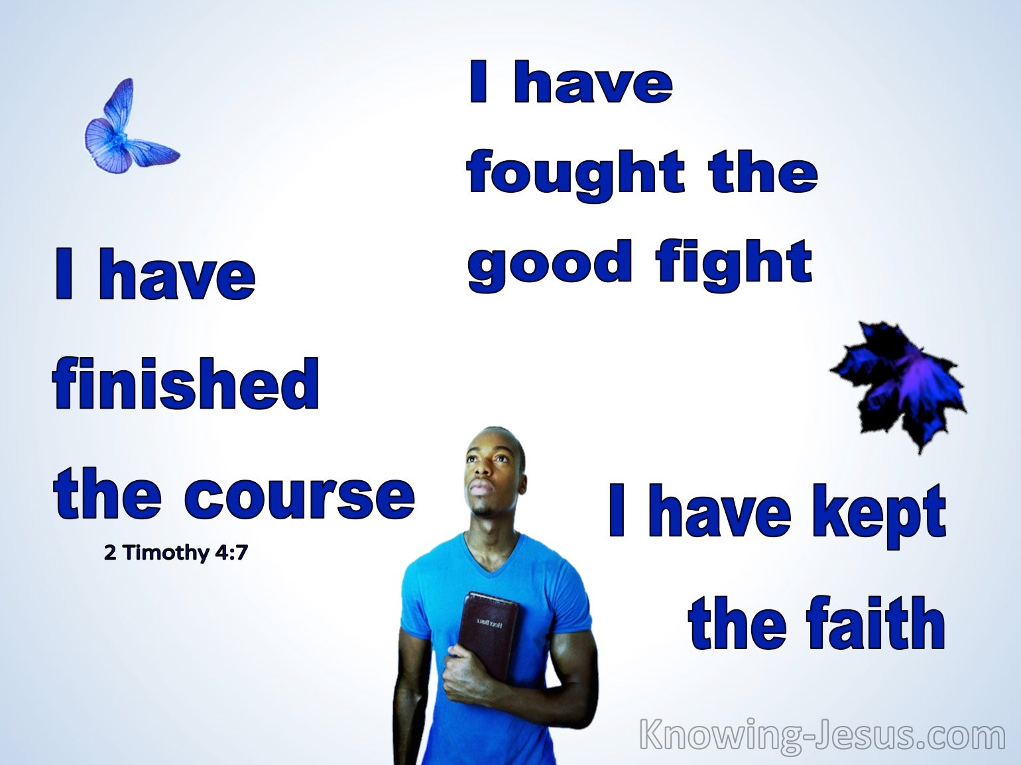
CHRIST THE ROCK CONGREGATION
SUNDAY AUGUST 13TH 2023
Sermon BY Marc Simeon
I HAVE KEPT THE FAITH

Slide 2
2Ti 4:7 I have fought the good fight, I have finished the race, I have kept the faith.
3Jo 1:4 I have no greater joy than to hear that my children walk in truth.

Slide 3
INTRODUCTION
Keeping the faith in God is a challenge, no matter what era we live in.
We tend to think that it is harder in our times than all previous eras to be a witness for God.

Slide 4
The fact to the matter is that, all believers face their fair share of adversities to maintain their genuine faith in God no matter what time in history they live in.
In our days, the enemy has changed tactics to pretend that all faiths are fictions.

Slide 5
We live in the era controlled by the faith called humanism that is masqueraded as science.
They would want you and I to believe that the science that they are heralding is objective and neutral, when in fact it is a faith of its own.

Slide 6
Most of what we’ve studied as scientific facts some 30 years ago have now being challenged by later discoveries.
The science we are being fed in our days is nothing but an assumption to challenge the biblical account of the origin of life.

Slide 7
Present science is the denial of the supernatural in order to uphold the belief that life is coincidental, naturalistic and purposeless.
For the most part, what we call scientific facts are really assumptions and presuppositions.
They want us to hold on to whatever they come up with until they find something better to tell us.

Slide 8
We are being bombarded with information that claims to be factual that contradicts the Bible, and a lot of Christians fall preys to it.
The modern day’s scientific advancements put mankind behind the steering wheel of their destiny.
We live in a time when human governments are trying their best to overrule God’s order over the creation.

Slide 9
We live in a time where signs and wonders are rare among Christians which would help to counter the claims of the opposition party.
We live in a time where truth is not absolute but subjective.

Slide 10
We live in a time where many so-called Christians practice faith deconstruction.
They pick and chose what they want from the bible to reconstruct their theology.

Slide 11
Many denominations take a pragmatic approach to the bible in order to line up with the demands of culture we live in.
Keeping the genuine faith in God is not only hard, but it becomes a lonely endeavor.

Slide 12
THE CHALLENGES PAUL FACED IN KEEPING HIS FAITH TO THE END
Paul had his fair share of obstacles to overcome in order to maintain his faith in God.
We also have our fair share of obstacles to overcome to hold on to our faith in God although they differ in nature than Paul’s.

Slide 13
Persecution was one of Paul’s greatest challenges.
The rejection of the new doctrine of salvation was another one.
The false brethren who were seeking to harm him were another challenge.

Slide 14
The false teachers who were invading the church presented another challenge.
The lack of funds to support the ministry was another challenge.
The lack of help and encouragement from other believers was another challenge of Paul.

Slide 15
The constant clashes with the Jewish religious leaders were some of Paul’s challenges.
The demonic attacks were another one of Paul’s obstacles.
The immaturity and vulnerability of the new believers were another one of Paul’s challenges.

Slide 16
The beating and the imprisonments were parts of Paul’s lot.
The physical illness that Paul suffered was another one of Paul’s hindrances.
To have kept the faith is an understatement. Paul managed to strive gloriously in his faith in the midst of all that were set against him. That’s exceptional!

Slide 17
PRESENT CHALLENGES IN KEEPING OF THE FAITH IN GOD
Depends on where you live the challenges differ for each believer.
People are being put to jail, beaten and killed for their faith in God in some corners of the world as we speak.

Slide 18
The invasion of immorality in the church and in all mainstreams of society is a great challenge to the modern believer.
The explosion of false doctrines and sects are stumbling blocks to contemporary Christians.

Slide 19
The great sense of disengagement of the believers in the things of God is another common challenge.
Autonomy and self-reliance among confessed Christians who sense no need for God’s guidance is another challenge.

Slide 20
Financial burden to advance the Kingdom of God is high on the list of the challenges of the believers in our time.
Fake brethrens, wolfs in sheep clothing is another one.
Secularism and materialism among believers are also high in the list.

Slide 21
The high cost of living causes the disappearance of full time Christian workers in the field.
The growing Biblical illiteracy of the believer is a great challenge in keeping the faith.

Slide 22
To keep the genuine faith in God in our time is nothing short than a gymnastic.
Heb 3:14 For we have become partakers of Christ if we hold the beginning of our confidence steadfast to the end,

Slide 23
THE CHRISTIAN LIFE IS LIKE A SPORT RACE
Christians must run the race according to the rules so that they would not be disqualified.
We must run the race to the end to be declared winners.
We run for a heavenly prize.

Slide 24
We run diligently, purposefully and expectantly.
1Co 9:24-27
24 ¶ Do you not know that those who run in a race all run, but one receives the prize? Run in such a way that you may obtain it.

Slide 25
25 And everyone who competes for the prize is temperate in all things. Now they do it to obtain a perishable crown, but we for an imperishable crown.
26 Therefore I run thus: not with uncertainty. Thus I fight: not as one who beats the air.

Slide 26
27 But I discipline my body and bring it into subjection, lest, when I have preached to others, I myself should become disqualified.

Slide 27
THE STRATEGY FOR RUNNING THE CHRISTIAN RACE
We run toward the goal.
We put away distractions.
We forget what is behind.
We keep the prize in mind.

Slide 28
Php 3:12-14
12 Not that I have already attained, or am already perfected; but I press on, that I may lay hold of that for which Christ Jesus has also laid hold of me.
13 Brethren, I do not count myself to have apprehended; but one thing I do, forgetting those things which are behind and reaching forward to those things which are ahead,

Slide 29
14 I press toward the goal for the prize of the upward call of God in Christ Jesus.
It is imperative for all of us Christians to understand that we must keep the faith in God all the way to the end to enter to heaven.
The faith in question must be as is revealed in the Word of God.

Slide 30
1Co 15:1 ¶ Moreover, brethren, I declare to you the gospel which I preached to you, which also you received and in which you stand,
2 by which also you are saved, if you hold fast that word which I preached to you--unless you believed in vain.
Any deviation from the true Gospel is a disqualification.

Slide 31
THE JOY AND GRATIFICATION OF WINNING THE RACE OF THE UPWARD CALL
2Ti 4:7 I have fought the good fight, I have finished the race, I have kept the faith.
8 Finally, there is laid up for me the crown of righteousness, which the Lord, the righteous Judge, will give to me on that Day, and not to me only but also to all who have loved His appearing.

Slide 32
Everyone who finishes the race well is declared a winner.
God’s race does not produce one winner over all others.
Everyone is in his own lane. The runners compete not against each other but against the hardships of their race.

Slide 33
Perseverance, steadfastness, endurance, discipline, focus, holiness and production are the strategies to win the race of the upward call.
The joy and fulfillment of winning the race can be felt while we are still living on earth.

Slide 34
For one to live to see the positive impacts of his dedication and diligences in God’s kingdom on earth is a gratifying experience.
Paul had the sense of accomplishment and a work well done for God even before his death.

Slide 35
Paul knew that he had scored greatly in expanding the Gospel of Jesus Christ.
Paul knew what was awaited for Him.
Paul longed for the day of his departure, so that his blessed hope could be actualized in heaven.

Slide 36
A crown of righteousness was in line for Paul.
Paul expected others who do like him to be rewarded in the same fashion.
The blessed hope of Paul is the common anticipation for all believers who labor for God.

Slide 37
CONCLUSION
What are those things that threaten you in your race?
Discouragement, passivity, fatigue, disengagement, distractions, procrastination and laziness are the common pitfalls for all runners of the race.

Slide 38
Comparison to others, self-interest and self-preservation may obscure the runners of the magnitude of the race.
Keeping the faith to the end means to overcome the enemy of our souls.
To keep the faith is to combat to the end.

Slide 39
To keep the faith is the greatest achievement in life.
This life is the bridge to eternity; how one finishes this race determines his/her eternal destiny.

Slide 40
2Ti 4:7 I have fought the good fight, I have finished the race, I have kept the faith.
3Jo 1:4 I have no greater joy than to hear that my children walk in truth.
Let it be so for you as well in Jesus’ Name!
AMEN!

