Slide 1
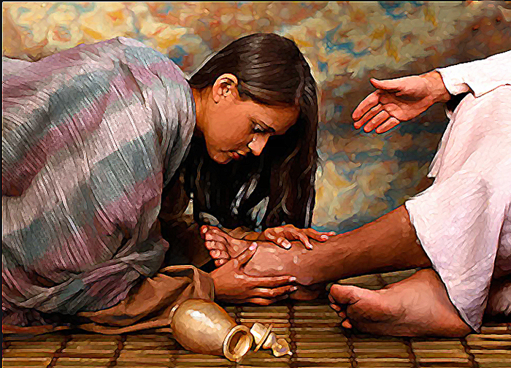
CHRIST THE ROCK CONGREGATION
SUNDAY MAY 14TH 2023
Sermon by Pastor Marc Simeon
What is the price of your sacrifice to God?

Slide 2
Reflexion of a sermon preached by Dr Adrian Roger
MARK 14 : 1-9
Mr 14:1 ¶ After two days it was the Passover and the Feast of Unleavened Bread. And the chief priests and the scribes sought how they might take Him by trickery and put Him to death.
2 But they said, "Not during the feast, lest there be an uproar of the people."

Slide 3
3 And being in Bethany at the house of Simon the leper, as He sat at the table, a woman came having an alabaster flask of very costly oil of spikenard. Then she broke the flask and poured it on His head.
4 But there were some who were indignant among themselves, and said, "Why was this fragrant oil wasted?

Slide 4
5 "For it might have been sold for more than three hundred denarii and given to the poor." And they criticized her sharply.
6 But Jesus said, "Let her alone. Why do you trouble her? She has done a good work for Me.
7 "For you have the poor with you always, and whenever you wish you may do them good; but Me you do not have always.

Slide 5
8 "She has done what she could. She has come beforehand to anoint My body for burial.
9 "Assuredly, I say to you, wherever this gospel is preached in the whole world, what this woman has done will also be told as a memorial to her."

Slide 6
Introduction
This remarkable story is recorded in all four gospels. Matthew, MarK, Luke and John.
It is a memorial to the action or gesture of a certain woman.
Jesus predicted that we would be preaching about it today.
Wherever the Gospel is preached, so will the account be remembered.

Slide 7
The stage:
In the aftermath of the resurrection of Lazarus.
Marie, Martha and Lazarus were friends of Jesus.
Jesus had many sleepovers in their house when he was in town.
Jesus was the guest of honor in the celebration that was going on.

Slide 8
We know that the event occurred in Bethany, but not in the house of Marie and Martha, but over Simon the Leper.
We know at least that Simon had been a leper at some point.
In Luke chapter 7: we know that He was a Pharisee.
In a sense it fits to say that two major miracles might have happened in this little town.

Slide 9
Jesus might have healed a Pharisee who had leprosy called Simon, who was throwing a thanksgiving party.
Mary and Martha who lived in the same proximity decided to make a joint party to celebrate the resurrection of Lazarus.
The Bible tells us that many distinguished people were present.

Slide 10
Many people who had come early in the Passover celebration from all parts of the world would have been there.
We know that many people wanted to see Lazarus who had been raise from the dead.
Martha is probably busy cooking.
Jesus is teaching.
Simon is entertaining the guests.
Marie as usual was at the feet of Jesus.

Slide 11
The surprising action of Mary
Marie was filled with love and admiration for Jesus.
Marie was once a prostitute before she met Jesus.
Jesus had restored her.
Jesus had raised her Brother from the dead

Slide 12
Marie found her own way to express her love and devotion to Jesus.
She only had one thing of value, and that wasn’t her skill or talents.
She was not special at anything.
She had something that meant a lot to her.

Slide 13
It takes a full year’s wage to pay for one.
She had a very expensive perfume—pure nard.
Imported probably from India.
She broke the seal that might have been made of glass or ceramic.

Slide 14
She poured the entire container on the head of Jesus.
Luke says she was crying—probably out of contentment.
The Bible also says that the aroma of the perfume filled the room.
While everybody liked the smell,
Not everyone was on board with the action of Marie.

Slide 15
THE ATTITUDE OF MARY
Marie did not care about criticism
She didn’t care about custom
She didn’t care about the cost
all she could see was her love for Jesus
she went further by getting down on her knees
  —let go her hair and
  began to wipe the feet of Jesus.

Slide 16
THE INDIGNATION OF THE SPECTATORS
The whole thing infuriated the spectators.
Simon was vexed of that act of worship, for he did not see Jesus as God.
And Judas was furious about the waste of the perfume, for it could be sold for a lot of money.

Slide 17
THE RESPONSE OF JESUS
6 But Jesus said, "Let her alone. Why do you trouble her? She has done a good work for Me.
7 "For you have the poor with you always, and whenever you wish you may do them good; but Me you do not have always.
8 "She has done what she could. She has come beforehand to anoint My body for burial.

Slide 18
Jesus was moved by Mary’s action.
Jesus was moved by what Marie did.
Jesus rebuke the people who were attacking her.
Jesus acknowledges that her action was timely with respect to the crucifixion and burial.
Jesus set a memorial for her action—

Slide 19
  Everyone, everywhere, every generation: present and future will know about her action.
  Mark 14:9 "Assuredly, I say to you, wherever this gospel is preached in the whole world, what this woman has done will also be told as a memorial to her."

Slide 20
Let us examine the good deed of Marie.
It was a good work
It was a misunderstood work
It was a memorable work
It was a personal act of worship
It was meaningful work

Slide 21
It had a prophetic component to it
It was a timely work.
It wasn’t Mary who had a problem but the people around her
When it come to your devotion to God,
  Don’t wait for others to stimulate you.
Don’t make a council to discuss what God put in your hearth to do.

Slide 22
Others may think that your sacrifice was a waste
Others may think that your sacrifice was insignificant, or pointless
Others may think that your sacrifice is too much. Pay no mind to them.
The anointing of Mary was the only one Jesus was going to have.

Slide 23
CONCLUSION
Jesus did not need any more burial but that of Marie.
She acted on time.
The body of Jesus did not decompose thanks to Marie.
Her sample action went a long way.

Slide 24
A sample gesture can be more significant than you may think.
Even a cup of water can save someone’s life.
What is the price of your sacrifice?
God can distinguish between sacrifice and leftover.

Slide 25
God doesn’t like leftovers
  He loves something that is dear to you.
  He loves something that cost you dearly.
  He wants the first place in your life.
  He wants the first part of your day.
  He wants the first of your money.
  He wants the best seat in your heart.
  He wants to be your best friend.
  He wants the highest royalty.
God will give significance to your little effort.
AMEN!

