Slide 1
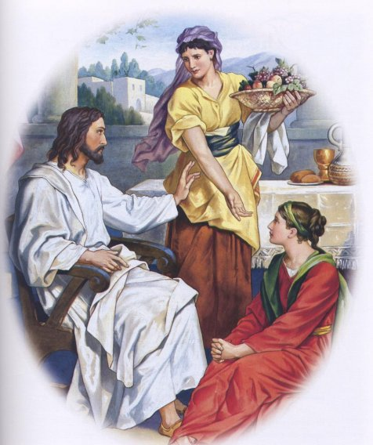
CHRIST THE ROCK CONGREGATION
SUNDAY MAY 7TH 2023
Sermon by Pastor Marc Simeon
Lu 10:41 And Jesus answered and said to her, "Martha, Martha, you are worried and troubled about many things.
42 "But one thing is needed, and
Mary has chosen that good part
which will not be taken away from her.".

Slide 2
LUKE 10:38-42
38 ¶ Now it happened as they went that He entered a certain village; and a certain woman named Martha welcomed Him into her house.
39 And she had a sister called Mary, who also sat at Jesus' feet and heard His word.

Slide 3
40 But Martha was distracted with much serving, and she approached Him and said, "Lord, do You not care that my sister has left me to serve alone? Therefore tell her to help me."

Slide 4
41 And Jesus answered and said to her, "Martha, Martha, you are worried and troubled about many things.
42 "But one thing is needed, and Mary has chosen that good part, which will not be taken away from her."

Slide 5
INTRODUCTION
The title of this message is choosing the good part.
Here in Luke 10 we find we find Jesus spending time with his favorite people.
We know all about the siblings in that family because all of them made some headlines in Jesus’ ministry.

Slide 6
We don't know how Jesus became so cling to them, but we see that Jesus felt really at home when he visited Martha, Mary and Lazarus.
Lazarus benefited from one of Jesus’ greatest miracles.
He was dead for 4 days before Jesus brought him back to life.

Slide 7
Jesus was always on the go, but when He got over Martha's House, Jesus could take off his shoes and relax a little bit.
It seems that each person in that family found his or her best way to make Jesus feel welcome.

Slide 8
When Lazarus was sick, they sent for Jesus saying “the one that you love is sick”, in other words “your good friend or your best friend is sick”.

Slide 9
THE WELCOME OF JESUS AT MARTHA’S HOUSE
The minute Jesus walked in that house the whole atmosphere changed.
Martha, obviously the eldest, sensed the immediate need to fix Jesus something to eat.
Much was involved in preparing that meal she had in mind.

Slide 10
She felt the urgency to get the food ready in the shortest delay.
If there was no water in the house, somebody had to go get it from the well.
If there was no meat, or vegetable, or whatever in the house for what she had in mind to cook, somebody had to go to the marketplace and get it.

Slide 11
There must have been enough wood to keep the fire going.
To get that food ready in Martha's expectation, more than one person was needed around the kitchen.

Slide 12
THE ALARMING BUSINESS OF MARTHA
Martha did not want to be rude at first, so she allowed her sister to stay with Jesus to keep him company.
She's now going in at full speed; she needed more help.

Slide 13
Each time she passes by, there was Mary gazing at Jesus, having the sweetest of conversation and listening to his teaching.
She must have done all the gestures that women do to get Mary's attention all to no avail.
As time went on, the more Angry Martha became with Mary

Slide 14
THE INDIGNATION OF MARTHA
Martha's frustration boiled to the point where she even blamed the insensitivity not just of Mary but also of Jesus.
She's about to explode; she’s way behind schedule, thanks to Mary.
The fire is dying, thanks to Mary.

Slide 15
She won't be able to do all the extra dishes that she had in mind to do, thanks to Mary.
Mary just sat there doing nothing.
Her business led her to undermine the value of what Mary was doing.
She felt vindicated to ask Jesus to speak to Mary.

Slide 16
She felt that it was wrong for Mary to just sit there and not helping, while she was doing all the work.
She valued what she was doing so much to the point of thinking that Mary was wasting her time seating at the feet of Jesus.
Martha is a perfectionist type; she's also very bossy without realizing it.

Slide 17
She felt that both Jesus and Mary needed a public lecture.
She was not hesitant to rebuke Jesus about the situation.
We can easily see that Martha was a good person, but she was carried away without realizing it.
All wives can turn classic Martha(s) at times,

Slide 18
The husband may prefer her company while she can value feeding him over spending intimate time with him.
When I just got married I became very angry at my wife sensing that she did not appreciate all the efforts I was making to provide for the home.

Slide 19
She had her own dream of us spending a lot more time together after marriage.
She did not seem to appreciate all the overtimes I was doing in to order to keep a roof over our head.
I felt that my providing made me the best husband in the world although romance was somewhat sacrificed in the process.

Slide 20
She would have preferred to settle for less in exchange for more quality time together with me.
I was very unhappy over her unhappiness.
We can frustrate ourselves in trying to do the unnecessary extras.

Slide 21
THE OUTBURST OF MARTHA
Marta rebuked Jesus by saying, “you mean that it doesn't bother you to see me killing myself in such a way, while Mary’s sitting there doing nothing?”
Mary is just wasting her time with you asking one silly question after the other while I'm running out of breath here.

Slide 22
If I was to ask all the ladies here to be honest, most will side with Martha.
Jesus answered Martha by asking her an agitating and irritating question.
“Martha, Martha, why do you worry for every little thing.
“Why do you have to be such a perfectionist?”

Slide 23
“Martha, your anger is getting the best of you.”
As a pastor I am a Martha type wanting things to be done well and on time.
When people don’t take their church assignments seriously I feel so angry on the inside.
Many a times, the very person who makes me so upset have the nerve to enjoy the service while I'm in flame. Lol

Slide 24
THE REBUKE OF JESUS TO MARTHA
Martha why do you take life so seriously?
Martha why you let the secondary things take so much of your energy?
Martha why do you want everyone to become busy bees like you?

Slide 25
Martha I did not come to your home to be a burden to you.
Martha I just came to spend some time with you.
The food you’re preparing for me is secondary to the quality time I wanted to spend with you.
Malta I came to enjoy your company.
Martha a simple noodle soup would do.

Slide 26
I stop by so that I can tell you important things about me.
Before long I am going to become a public spectacle.
Martha, this could be our last time together before my crucifixion.
I want to tell you things about heaven because I will be returning pretty soon to my Father’s house.

Slide 27
CHOOSING THE GOOD PART
Mary has chosen the good part; she’s storing up my words that cannot be taken away from her.
Her faith is been strengthened by what she's hearing from me.
She's happy and you are frustrated.
It takes me a lot of discipline to push the [stop button] when I am feeling like Martha.

Slide 28
You have a long list of things to be done and you get irritated when people don't join hands in getting them done.
The do-nothing people want to add to your burden by giving you more things to do.
You’re burning up and no one seems to notice.

Slide 29
I learn to drop everything and go sit with Jesus when I'm feeling frustrated now.
It takes a lot of discipline, but I'm at the point where I have to leave things undone to spend time with Jesus.
After I do my best I try to no longer care of the outcome.

Slide 30
I have to realize that God did not choose me because of my excellence, but because of my intimacy with Him.
It is imperative for people who are working for God to understand what Satan is trying to do.
We must understand how God sets priorities.
Times of worship, prayer and Bible reading rank the highest in God’s list than all others.

Slide 31
Never allow the work you do for God to diminish your love for Him.
We are not like hired servants but we are Sons of the kingdom.
God prefers spending time with us above anything that we could be doing for him.
Martha did not have a good day, but Mary had a blast.

Slide 32
CONCLUSION
While we get busy working for God, we must keep our attitude at check.
The work of God is greatly damaged because of lack of workers.
The urgency to join the hands to get the work done is paramount.

Slide 33
Yet, you cannot afford to turn to an impatient and agitated Martha.
You cannot afford to lose the joy of your salvation.
You cannot afford to lose your good disposition.

Slide 34
Every Christian is mandated to join hand in the work of God to protect those who are already doing too much.
This example was not given to discourage people from doing God’s work but to maintain balance and priority.
If everyone does his part, no one will be burnt out.

Slide 35
We cannot allow our service to God to make us angry at the very God we’re serving.
May God help all the Martha’s out there who are working so hard, but miss their part in serving God!
Amen.

