Slide 1
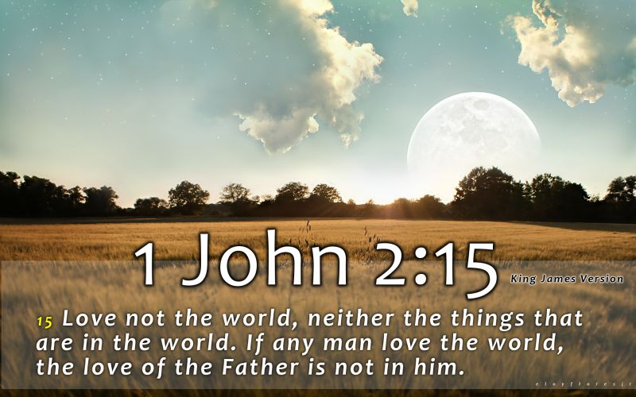
CHRIST THE ROCK CONGREGATION
SUNDAY MAY 28TH 2023
Sermon by
Pastor Marc Simeon
DO NOT LOVE THE WORLD OR THE THINGS IN THE WORLD.

Slide 2
1John 2:15-17
1Jo 2:15 Do not love the world or the things in the world. If anyone loves the world, the love of the Father is not in him.

Slide 3
16 For all that is in the world--the lust of the flesh, the lust of the eyes, and the pride of life--is not of the Father but is of the world.
17 And the world is passing away, and the lust of it; but he who does the will of God abides forever.

Slide 4
INTRODUCTION
Nothing is more hurtful than to watch Christians going backward in their walks with God.
The worse part of it is that some of these so-called Christians begin to drift away when things begin to go well for them in life.
Many have had their best moments with God while they were going through trials and adversities.

Slide 5
While they were in the desert in the dependence of the daily manna from heaven, everything was fine between them and God.
After they cross the Jordan River to their Promised Land, that’s when their breach between them God begin to enlarge.

Slide 6
Det 6:10-12
10 "So it shall be, when the LORD your God brings you into the land of which He swore to your fathers, to Abraham, Isaac, and Jacob, to give you large and beautiful cities which you did not build,

Slide 7
11 "houses full of all good things, which you did not fill, hewn-out wells which you did not dig, vineyards and olive trees which you did not plant-when you have eaten and are full-
12 "then beware, lest you forget the LORD who brought you out of the land of Egypt, from the house of bondage.

Slide 8
The love of this world is so subtle that one may not notice that he is already enticed by it.
The love of this world dries up the love that God intended for mankind to have toward one another.
The love of this world is a philosophy and a way of life.

Slide 9
When animated by the love of this world, you become envious, unsatisfied and greedy.
You become insensible to the needs of others, prideful, egocentric, and always comparing with others.
The love of this world causes you to become stingy with God and very weak for money.

Slide 10
The love of this causes a lot of people to lose their health in making excess in order to accumulate more money.
Your entire existence revolves around material possession and getting ahead in the competition.

Slide 11
Lot was living close to his uncle Abraham, then the love this world got a hold of him.
He made the choice to move to Sodom without taking into account the moral and spiritual depravation of the Sodomites.

Slide 12
Sodom was so good for business; it was compared to Eden.
Not safe to raise a righteous family but very good for the livestock business.
Lot didn’t think that his daughters would be in need of godly husbands some days.

Slide 13
Lot’s wife was having the time of her life with the booming business of her husband.
When it came time to leave Sodom empty handed she could not bear the thought; she looked back and turned to a pillar of salt.
Where your treasure is, there also will be your heart.

Slide 14
CHOOSING BETWEEN GOD AND MAMON
Mt 6:24 "No one can serve two masters; for either he will hate the one and love the other, or else he will be loyal to the one and despise the other. You cannot serve God and mammon.
God and Mamon can never get alone.
God is extremely jealous.

Slide 15
God requires preeminence in all our endeavors.
God wants your full devotion, body, mind and spirit.
God observes your enthusiasm when it comes to worldly pleasures with respect to how you serve Him.

Slide 16
Many Christians make God the side lover and Mamon the main one by their actions.
Some are trying to keep both lovers under the same roof, but it will never work with God.
God accepts no rivalry.

Slide 17
ARE YOU SEEKING TO PLEASE GOD OR MEN ?
Ga 1:10 ¶ ¶ For do I now persuade men, or God? Or do I seek to please men? For if I still pleased men, I would not be a bondservant of Christ.
Peers pressure is real no matter what age or social class one belongs to.

Slide 18
We do a lot to be approved by men.
We want people to speak favorably about us.
We live beyond our means just to make an impression on people.
We put our spiritual life on the line in exchange for the glory of this world.

Slide 19
Examine your life this morning to determine what exactly you’re trying to achieve by all your hard work.
Both pleasing God or pleasing men require a lot of effort.
Are your motives truly to please God with your life?

Slide 20
RESIST CONFORMITY TO THE DEMANDS OF THIS PRESENT AGE
Ro 12:1-4
¶ I beseech you therefore, brethren, by the mercies of God, that you present your bodies a living sacrifice, holy, acceptable to God, which is your reasonable service.

Slide 21
2 And do not be conformed to this world, but be transformed by the renewing of your mind, that you may prove what is that good and acceptable and perfect will of God.
Every era comes with its set of demands that differ from previous and future eras.

Slide 22
There was a time when you needed a lot of livestock and lands to be considered important.
There was another time that was dominated by knowledge and philosophies.
In another era, the number of children you put on earth was considered the demand of the time.

Slide 23
In another era, it was sexual freedom that was considered the push of the time.
In our time, it is wealth accumulation, sexual freedom, free speech, women revolution, power, profession, popularity and personal pride that seem to win the day.

Slide 24
The world in under the ruling of Satan, so he sets traps to mold us to his liking.
The word of God transcends time;, it never changes.
However, because of the changing aspect of this world, the Holy Spirit keeps on upgrading us so that we can identify the will of God.

Slide 25
THE LOVE OF MONEY IS THE ROOT OF ALL EVIL
1Ti 6:6-12 ¶ Now godliness with contentment is great gain.
7 For we brought nothing into this world, and it is certain we can carry nothing out.
8 And having food and clothing, with these we shall be content.

Slide 26
9 But those who desire to be rich fall into temptation and a snare, and into many foolish and harmful lusts which drown men in destruction and perdition.
10 For the love of money is a root of all kinds of evil, for which some have strayed from the faith in their greediness, and pierced themselves through with many sorrows.
11 But you, O man of God, flee these things and pursue righteousness, godliness, faith, love, patience, gentleness.

Slide 27
Nothing drains the soul faster as the love of money.
Nothing is more addictive than the love of money.
At some point, some people cannot even tell you why they are still pursuing money as if their next breath depended on it.

Slide 28
They have it, yet they want increasingly more of it.
Some people could live 10 lifetimes with their present wealth without ever setting foot in a workplace.
These people are the very ones who would do the unthinkable to acquire more money.

Slide 29
This is the vanity of this world.
It promises you joy and happiness if you could only accumulate more, yet, it repeats the same line each time you move higher.

Slide 30
CONCLUSION
Heb 13:1-5 ¶ Heb 13:1 ¶ Let brotherly love continue.
2 Do not forget to entertain strangers, for by so doing some have unwittingly entertained angels.
3 Remember the prisoners as if chained with them--those who are mistreated--since you yourselves are in the body also.

Slide 31
5 Let your conduct be without covetousness; be content with such things as you have. For He Himself has said, "I will never leave you nor forsake you.“
Not loving this world does not mean that Christians should not like nice things.

Slide 32
It doesn’t that Christians are encouraged to be poor in order to be pleasing to God.
It simply means that we must be watchful to get rid of anything and everything that slows our spiritual development.

Slide 33
We need to be watchful that nothing takes the place of God in our lives: be it job, career, education, romance, wealth, pleasure and all other hobbies.
Evaluate your life to see how much you are presently doing just to foster a closer intimacy with God.
Ask God to show the hidden rivals we bring in our lives that make Him feel uncomfortable.

Slide 34
Check your schedule and make sure God is honored in it.
Enhance your prayer life and it will be for your own good.
Be aware that most apparent opportunities that come out of the blue are traps to slow your walk with God.

Slide 35
Make no decision without first consulting God.
God will always bless His will if we chose to follow it.
1Johnn 2:15-17
1Jo 2:15 Do not love the world or the things in the world. If anyone loves the world, the love of the Father is not in him.

Slide 36
16 For all that is in the world--the lust of the flesh, the lust of the eyes, and the pride of life--is not of the Father but is of the world.
17 And the world is passing away, and the lust of it; but he who does the will of God abides forever.
AMEN !

