Slide 1

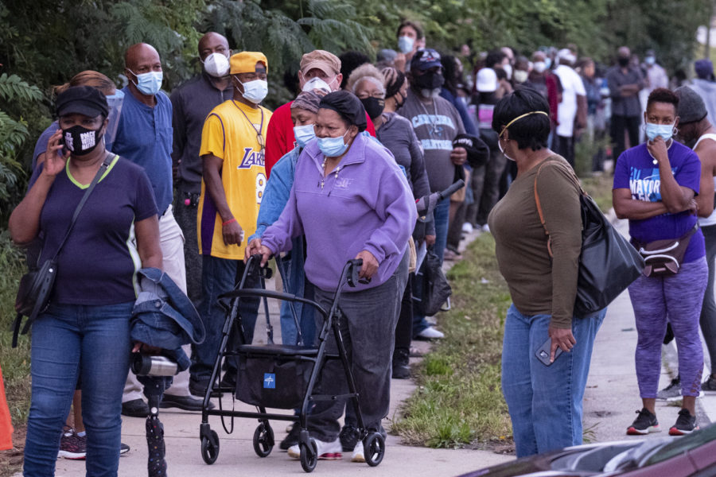
CHRIST THE ROCK CONGREGATION
SUNDY FEBRUARY 19TH 2023
Sermon by Pastor
MARC SIMEON
GOD DOES NOT RUN HIS KINGDOM BY POPULARITY CONTEST

Slide 2
1Kings 18:21 ¶ And Elijah came to all the people, and said, "How long will you falter between two opinions? If the LORD is God, follow Him; but if Baal, follow him." But the people answered him not a word.

Slide 3
Matthew 4:8-11
8 Again, the devil took Him up on an exceedingly high mountain, and showed Him all the kingdoms of the world and their glory.
9 And he said to Him, "All these things I will give You if You will fall down and worship me."

Slide 4
10 Then Jesus said to him, "Away with you, Satan! For it is written, 'You shall worship the LORD your God, and Him only you shall serve.'"
11 Then the devil left Him, and behold, angels came and ministered to Him.

Slide 5
INTRODUCTION
When we look at our world today, there’s a quest for popularity that is unparalleled to any previous generations.
We bombard the social Media to make ourselves known in quest for love and acceptance and popularity.

Slide 6
The way we are segregated by race, by economic status, by nationalities, and by geographical boundaries, the urge to form one society, one big human family is somewhat rational.
Popularity is a very powerful force, no one wants to be invisible, and everyone wants to be recognized.

Slide 7
Some would say, “Popularity is everything”.
Billions are spent in advertising every year for the sake of maximizing popularity.
I read an article that says that the artists who perform in the America Super Balls don’t get paid.

Slide 8
They do it for the sake of worldwide exposure.
Some people lie in order to impose a good impression on others for popularity and affirmation.
Some people live beyond their means in order to project a positive image, in order to boost their popularity.

Slide 9
Deception and pretence are everywhere and at every level in order to boost popularity.
To be loved and accepted is at the core of every human being and it should happen naturally.
The quest for popularity affects all aspects of life. It is the drive in the business and political world.

Slide 10
To become popular may require a lot of sacrifices
Some have joined gangs for popularity and respect.
You may have to do something outrageous and sinful to achieve a certain level of popularity and respect among your peers.

Slide 11
The children who display the least respect for authority figures like (parents, teachers, police), are the envies of most of their peers.
This idea of getting popularity by being bad predates human history.
Before there was ever a physical world and a spiritual world God has always existed from all eternities.

Slide 12
God is the Father of the spirit world just as He is the Father of the physical world
He created a host of angelic beings and placed each one in their respective ranks and jurisdictions.
We don’t know what length of time it took, but eventually a problem occurred in the kingdom of God.

Slide 13
One of the high rank officers of God began to show signs of rebellion.
One particular being became envious of the Creator God Himself.
This particular being was so high in rank and so decorated with honor and beauty that he became prideful.
This being began to envy to receive the same glory and worship that the Creator God was getting out of His creation

Slide 14
THE MANAGER WHO ENVIED THE OWNER OF THE COMPANY
Satan is like a manager who envies the owner of an enterprise.
All a sudden, he envies the fact that the owner does not have to punch in when he comes;
He envies that the owner can stay home if he wishes;

Slide 15
He envies the fact that the owner lives in the biggest house in town; drives the most expensive car, etc.
All a sudden, consumed by envy, a shift in the manager’s thinking pattern is developed.
Just because he was well paid, he assumed himself as a co-owner

Slide 16
Just because he was given special privileges, he assumed himself equal to the owner
Just because he knows so much confidential information about the company, he feels that all his wishes should be granted.
One day, the manager squares up with owner in demand for more rights and joint ownership.

Slide 17
While thinking that he was indispensable to the company, to his greatest surprise, He got fired on the spot.
In his vexation for his revocation and in retaliation, he sets out to destroy the very company that made him who he was.

Slide 18
He knew some of the next projects of the company.
In his anger, he gathers a bunch of the supporters who got fired with him and began an operation of destruction

Slide 19
THE FALL OF LUCIFER
Isaiah 14 ; 12-16
Isa 14:12 "How you are fallen from heaven, O Lucifer, son of the morning! How you are cut down to the ground, You who weakened the nations!

Slide 20
13 For you have said in your heart: 'I will ascend into heaven, I will exalt my throne above the stars of God; I will also sit on the mount of the congregation On the farthest sides of the north;
14 I will ascend above the heights of the clouds, I will be like the Most High.'

Slide 21
15 Yet you shall be brought down to Sheol, To the lowest depths of the Pit.
16 "Those who see you will gaze at you, And consider you, saying: 'Is this the man who made the earth tremble, Who shook kingdoms,

Slide 22
Revelation 12:7-9
7 And war broke out in heaven: Michael and his angels fought with the dragon; and the dragon and his angels fought,
8 but they did not prevail, nor was a place found for them in heaven any longer.

Slide 23
9 So the great dragon was cast out, that serpent of old, called the Devil and Satan, who deceives the whole world; he was cast to the earth, and his angels were cast out with him.
Satan relies always on his popularity to maintain a seat in the heart of the world.

Slide 24
He is the father of lies
He is the father of deception and make belief
He is the father of ignorance
He is the father of arrogance
He is the father of destruction
He is the father of rebellion
He is the father of greed

Slide 25
He is the father of injustice
He is the father of stealing
He is the father of unforgiveness
He is the father of evil
He is the father of pride
He is the father of division
He is the father of shame and disgrace

Slide 26
He is the father of selfishness
He is the father killing stealing and destroying
He is the enemy of peace
He is the enemy of love
He is the enemy of joy
He is the enemy of righteousness
He is the enemy of unity

Slide 27
He is the enemy of grace
He is the enemy of contentment.
Satan always wants to challenge God in a popularity contest.
With his many deceptions, the devil has managed to steal the hearts of many.

Slide 28
He was so popular in heaven that at his fall, a third of the angels of God had fallen with him
Can you believe the catastrophic disorder that one being can cause to disrupt the heavens of one third of its stars.

Slide 29
We’re talking about celestial Beings that have been in the presence of God an indefinite period of time; powerful angels, powerful dominions who have fallen by the deceptions of Lucifer.
The devil knows about the power of popularity, he lives every minute of his existence in quest for popularity and dominance.

Slide 30
GOD DOES NOT RUN HIS KINGDOM ON POPULARITY CONTEST
Satan is a mastermind and a great deceiver.
With his many lies, he manages to maintain a superior popularity over God among all his subjects.
Even with the presence and influence of Christianity in our time, Satan remains more popular than God in this realm.

Slide 31
The good news is, God does not need to win the popularity contest over Satan to maintain his seat as the Supreme Ruler of the universe.
Satan was all time popular on earth as if he had won the battle, yet God chose one man named Enoch the grandfather of Noah to make alliance with.

Slide 32
Through Enoch’s lineage, God destroyed everyone else with the flood and repopulated the earth with one family. You tell me who is in charge?
When they repopulated the earth, Satan got busy again and stole the hearts of everyone on earth.
They began to build the Tower of Babel. God stepped in again and said, I don’t think so!

Slide 33
He confounded their languages and everyone became confused and they parted their ways and abandoned the project. You tell me who is in charge?
In the midst of it all, Satan got busy again and stole the hearts of every living being living on planet earth.
In the midst of it God pick Abram a former idol worshiper and made a covenant with him.

Slide 34
From that point on God decided to get in the competition with Satan.
God said, “I am going to make me a nation that carries my name through the ancestral line of Abraham.
Satan got busy again by the time of Moses not even the Children of Israel had a good knowledge of God.

Slide 35
The Jewish people did not even know the name of their God, yet God removed all of them out of Egypt in one day, by beating Satan in every game that was on the table. You tell me who is in charge?
God opened the Red Sea, fed the Israelites for 40 years in the desert and established them as a nation. You tell me who is in charge?

Slide 36
Satan got busy again, after the death of the prominent leaders like Moses and Joshua and his generation, the Israelites forgot about their God and began to worship the more popular gods.
God sent famine and war and pestilence and sicknesses to them as promised.

Slide 37
Though God always loses the popularity contest against Satan on earth but he never lost his seat as Almighty God and Supreme ruler of the universe.

Slide 38
SATAN FAILED TO GOD IN THE TEST OF POWER AGAINST GOD
When Satan’s popularity was in its all time high in Israel to the point that they killed all the prophets of God and replace them by prophets of Baal

Slide 39
Prophet Elisha says let’s not determine who the real God of the land is by popularity contest.
Let’s put them in the ring to see who is the strongest.
Let He who is the real true God bring fire and consume the sacrifice.
Let the God who wins be the God of the whole Land.

Slide 40
So they created the setting for the battle of the gods; to their biggest surprise, even with 850 cheerleaders shouting for Satan versus a handful of people for God, Satan was nowhere to be found that day.
The devotees did all the their power to bring Satan to the scene, all to no avail
He could not show up in person to face the humiliation in front of all of these people he had deceived for so long.

Slide 41
Although Satan did not show up, God showed up and consumed the wet sacrifice with fire and was declared the winner of the match.
After it was all settled Elisha just raised his hand and signaled the true God to manifest Himself.
before you know it all the sacrifices were consumed by fire. You tell me who is in charge?

Slide 42
Satan got more popular again in the land which caused God to vanish the ten tribes and consequently the rest of Israel.
400 years of silence from the part of God went by, and Satan got very popular again, yet when it seemed that the battle was lost, God showed up with the promised Messiah.
Satan tried his best to destroy Jesus to no avail, then Satan knew right there and then that the tide was going to change for him.

Slide 43
Satan inspired the killing of Jesus, but in three days, he was found alive
Jesus established His church, and Satan has being battling the church for 2000 years.
At times, Satan becomes even more popular than Jesus in the very church that Jesus created.

Slide 44
Now that the age of grace is drawing to a close, a segment of the church begins to be showered by the latter rain of grace.
The church is now again beginning to exercise its authority while a great majority is falling into apostasy.
The kingdom of Satan is in a big panic right now; his all time high popularity will not be able to save him from the calamities that are closing in on him and his kingdom.

Slide 45
Once the fragile church of Christ is removed from earth, then the real showdown will begin.
It will be Power versus power.
Satan will run another popularity contest to line all the nations against Israel.
Jesus will be coming to the scene with his kingdom and his entourage and sit on the throne of David for 1000 years, meanwhile the popular god of this age will be locked up in chains.

Slide 46
After the reign of Christ, Satan will be released from prison, and he will run his last popularity contest against God.
After his release, in no time, the master of popularity will gather all the nations of the earth against the Holy city of God.
At which point God will no longer have any interest on this planet.

Slide 47
With all the insulations removed, meaning the people of interest who kept God from destroying this earth, God will send His wrap and consume this whole physical creation.
Satan will be thrown in the lake of fire to be tormented day and night for ever and ever
And the Eternal God will begin a new project of creation where evil can never permeate.

Slide 48
God does not run His kingdom by popularity contest but He always wins.

Slide 49
CONCLUSION
Revelation 21:1-5
1 ¶ Now I saw a new heaven and a new earth, for the first heaven and the first earth had passed away. Also there was no more sea.
2 Then I, John, saw the holy city, New Jerusalem, coming down out of heaven from God, prepared as a bride adorned for her husband.

Slide 50
3 And I heard a loud voice from heaven saying, "Behold, the tabernacle of God is with men, and He will dwell with them, and they shall be His people. God Himself will be with them and be their God.
4 "And God will wipe away every tear from their eyes; there shall be no more death, nor sorrow, nor crying. There shall be no more pain, for the former things have passed away."

Slide 51
5 Then He who sat on the throne said, "Behold, I make all things new." And He said to me, "Write, for these words are true and faithful."
God does not run His kingdom by popularity contest but He always wins.
AMEN

