Slide 1
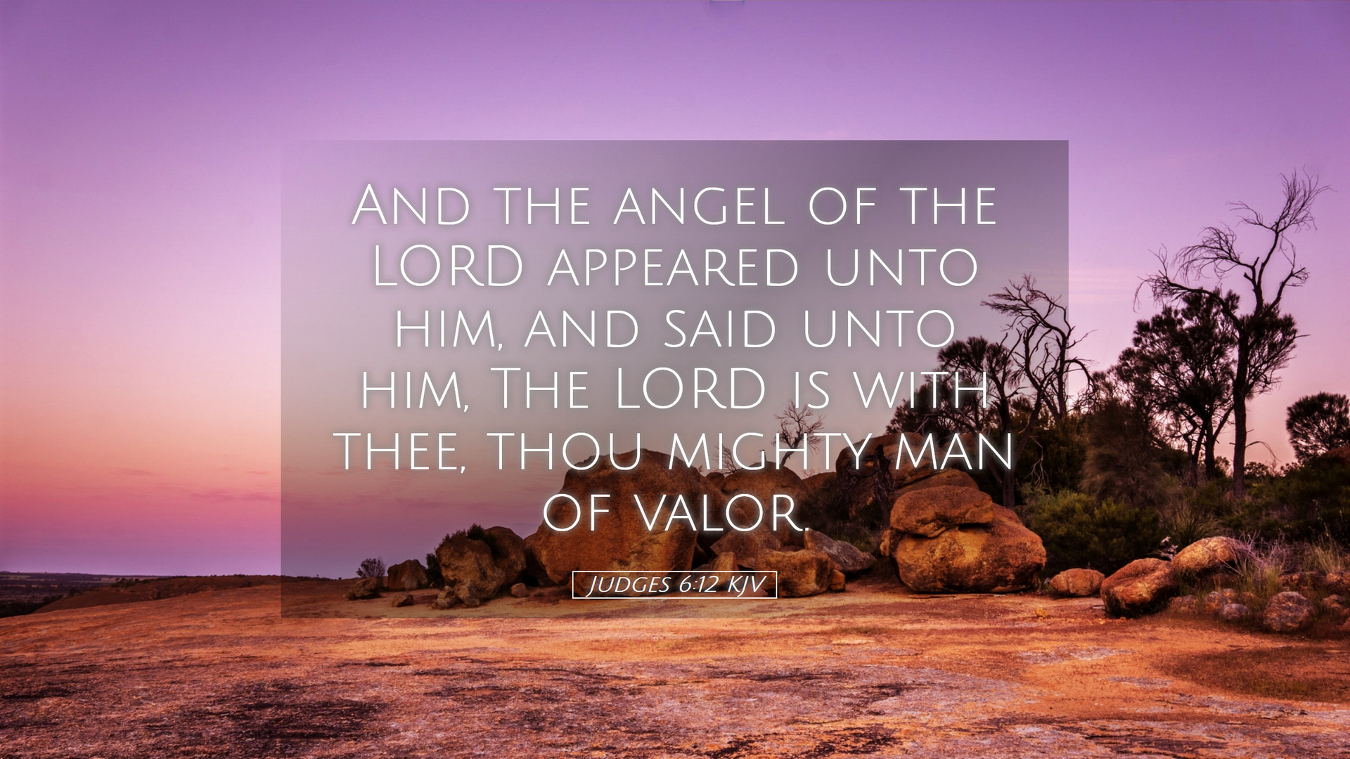
CHRIST THE ROCK CONGREGATION
SUNDY FEBRUARY 12TH 2023
Sermon by Pastor
MARC SIMEON
GIDEON A MIGHTY MAN OF VALOR IN CAGE

Slide 2
Judges 6:1-6
1 ¶ Then the children of Israel did evil in the sight of the LORD. So the LORD delivered them into the hand of Midian for seven years,
2 and the hand of Midian prevailed against Israel. Because of the Midianites, the children of Israel made for themselves the dens, the caves, and the strongholds which are in the mountains. [Living in holes]

Slide 3
3 So it was, whenever Israel had sown, Midianites would come up; also Amalekites and the people of the East would come up against them. [3 x factor]
4 Then they would encamp against them and destroy the produce of the earth as far as Gaza, and leave no sustenance for Israel, neither sheep nor ox nor donkey.

Slide 4
5 For they would come up with their livestock and their tents, coming in as numerous as locusts; both they and their camels were without number; and they would enter the land to destroy it.
6 So Israel was greatly impoverished because of the Midianites, and the children of Israel cried out to the LORD. [Finally]

Slide 5
Judges 6:11-16
11 ¶ Now the Angel of the LORD came and sat under the terebinth tree which was in Ophrah, which belonged to Joash the Abiezrite, while his son Gideon threshed wheat in the winepress, in order to hide it from the Midianites.
12 And the Angel of the LORD appeared to him, and said to him, "The LORD is with you, you mighty man of valor!"

Slide 6
13 Gideon said to Him, "O my lord, if the LORD is with us, why then has all this happened to us? And where are all His miracles which our fathers told us about, saying, 'Did not the LORD bring us up from Egypt?' But now the LORD has forsaken us and delivered us into the hands of the Midianites."

Slide 7
14 Then the LORD turned to him and said, "Go in this might of yours, and you shall save Israel from the hand of the Midianites. Have I not sent you?"
15 So he said to Him, "O my Lord, how can I save Israel? Indeed my clan is the weakest in Manasseh, and I am the least in my father's house."
16 And the LORD said to him, "Surely I will be with you, and you shall defeat the Midianites as one man."

Slide 8
INTRODUCTION
When we read the story of Gideon we can see that everyone on earth is walking around with unclaimed titles.
There are many unclaimed packages from heaven that came under the names that no one recognizes.

Slide 9
There are many salutations addressed to us that we do not respond to because we don't know our proper names, meaning our spiritual names.
The name that God gives us matches our personality and our missions in this life.
Because we don't know our God-given name, we respond to other self-inflicted names that are imposed upon us.

Slide 10
We accept the label tag that society places on us.
We accept the names that our social-economic status imposes upon us.
We accept the names that our enemies place on us.
We accept the names that the devil places on us.

Slide 11
We call ourselves names associated with defeat, failure and disappointment.
What is the name on your birth certificate?
What is the name on your God's birth certificate?
Are both your names the same?

Slide 12
THE CALL OF GIDEON
We find a man in the Bible that did not go by the name tag that God gave him.
Gideon was teased by the salutation he received from God.
Social economic conditions are powerful molds. They can press you to the point that it becomes nearly impossible to be reshaped properly.

Slide 13
The entire environment you live in poses a name tag on you, and that name is reinforced in all your interactions with others.
If you live in a swamp, it's hard to hide it from others. You smell like it; you have mud in your feet and on your clothes.
Your worldviews may reflect those of the people who live there with you.

Slide 14
Gideon was living a nightmare; he was experiencing a national shame.
There was No King, no leader, no hope of change.
Israel was occupied by the Midianites.
The Dominion of the Midianites was a humiliating and destructive one.

Slide 15
The Midianites took pleasure in Harrassing the Jews.
They managed to force the Jews to flee to the mountains and live in holes and dens.
When the Jews planted their fields, before the harvest was ripe the Midianites would bring their animals to eat all the products of the field.

Slide 16
If they realized they had some grains saved, they would come to their houses and seize them.
If they were milling some grains for food, they had to do it in secret.
3 groups of people came to reinforce the dominion of the Madianites. The Madianites, the Amalekites and the people of the East.
Gideon was trapped in that system.

Slide 17
There was no United Nation to call upon.
There were no big brothers to come to their rescue.
The morality level of the young Israelites was very low.
Gideon was enduring an unending oppression when he received a peculiar salutation from God.

Slide 18
Gideon was greeted by a name he never knew he possessed:. Mighty Men of Valor
Gideon wanted to ensure it was not a joke that was being pulled on him.
He felt that was at the very bottom of the societal latter.
His nation was occupied.

Slide 19
His family was poor.
He was the poorest and the youngest of his family.
The greeting was accompanied with a command to go and deliver Israel with the strength that he already had, although unknown to him.

Slide 20
GIDEON’S FIRST ASSIGNMENT TO TEAR THE ALTAR OF BAAL DOWN
Judges 6:25-26
25 ¶ Now it came to pass the same night that the LORD said to him, "Take your father's young bull, the second bull of seven years old, and tear down the altar of Baal that your father has, and cut down the wooden image that is beside it;

Slide 21
26 "and build an altar to the LORD your God on top of this rock in the proper arrangement, and take the second bull and offer a burnt sacrifice with the wood of the image which you shall cut down."
The first assignment of Gideon was to destroy the altar of Baal that was in his family compound.

Slide 22
He was also to build an altar dedicated to the Lord in the place.
Who would have thought that Gideon’s identity crisis was linked to the altar of Baal.
The Israelites worshiped Baal out of fear in search of protection and prosperity.

Slide 23
Unknowing to them, the altar of Baal was the prime reason for their dilemma.
Before Gideon could enter into God’s identity, he had to be freed from the grip of Baal.
Gideon fought Baal for his personal freedom.
Gideon had to get weed off the altar of Baal so that he could free his family.

Slide 24
Gideon would continue to tear the altars of Baal throughout the land to free his nation from the dominion of the Midianites.
The first reason they lost their dignity and their sovereignty as a nation, was because they began to worship these pagan deities, causing God to remove his protection from them.

Slide 25
So long that the altar of Baal remained in Gideon’s family, he could never enter into God’s intended destiny for his life.

Slide 26
THE TEARING DOWN OF THE ALTAR OF BAAL
Jg 6:27 So Gideon took ten men from among his servants and did as the LORD had said to him. But because he feared his father's household and the men of the city too much to do it by day, he did it by night.
Gideon mounted enough courage to do the job secretly by night.

Slide 27
It’s okay to stumble a little in your first assignments for God,, but get the job done anyway.
Do it at night if you’re afraid to do it during the day.
Do it secretly if you don’t yet have the courage to do it openly.

Slide 28
When the people woke up in the morning they found out what Gideon had done, they wanted to stone Gideon out of the fear of Baal.
It took the action of Gideon to expose the weakness of Baal.
Satan rules by propaganda.

Slide 29
The people feared for their lives of what they thought Baal’s repercussions would be because of Gideon’s action.
The father of Gideon said let Baal defend himself if he is god.
After a few days, seeing that Baal did not kill Gideon, they then gave Gideon the name of Jeru-Baal.

Slide 30
Meaning: the boy that beat Baal.
The new name was an improvement but it still did not match God's intended name for Gideon.
Your environment may adjust your name based on your latest performance or lack of, but they can never match the name that God has destined for you.

Slide 31
HOW TO EMBRACE GOD’S IDENTITY?
The small victories will instill faith in you and in others.
After beating Baal, Gideon’s confidence did not rise immediately.
He was still trapped in self-defeating attitude.

Slide 32
Gideon refused to come out of the shell of the wimp he thought of himself to embrace the image of the (MMV) Mighty Man of Valor that God created him for.
There is a sense of safety when one admits he is a coward, he has nothing to prove for he already accepts defeat.

Slide 33
God had to prove it over and over to Gideon that he was the man of the hour.
With God's help Gideon was able to bring peace and restoration to the land.
He became the hero and the judge of Israel for the rest of his life.

Slide 34
God showed Gideon that he didn't need much to do much.
With a handful of soldiers, Gideon was able to defeat the Midianites in battle on behalf of Israel.
Satan profits when we accept the identity that he places on us.

Slide 35
There will always be external forces to fixate you and to reinforce the image that the devil wants to impose on you.
You need to embrace God’s identity by faith and not by sight.
The strength is already in you, you just have to release it.

Slide 36
To release it, you need to believe that you have it.
As you embrace and engage your mission, self-discovery will happen.
As you take your eyes off your limitations unto God’s omnipotence, you will realize that victory is not acheived by might nor by man’s power but by the Spirit of God.

Slide 37
CONCLUSION
What will it take for you to adjust your conceptions of yourself?
What would it take for you to embrace your God given identity?
What is your first assignment in claiming your proper identity?
What is your immediate fear?

Slide 38
Gideon feared his family.
Gideon feared the worshipers of Baal.
Gideon feared the people in his own family.
Gideon feared the Midianites.
Gideon had to face each of his fears to claim his proper name of Men of Valor,

Slide 39
God was patient with him as God is being patient with you.
Although God assigns you a spiritual identity, you still have your part to play to claim it.
You must never lose sight whose you are, so that you can embrace who He makes you to be.

Slide 40
You have to come out of your caves and dens as safe as they may have made you feel to embrace the glorious title That God destined to you.
Always aspire to actualize the true meaning of the name tag that God assigned to you.

Slide 41
May God help you to understand this message, so that you can begin to pave your way from defeat and insecurity to victory.
AMEN!

