Slide 1

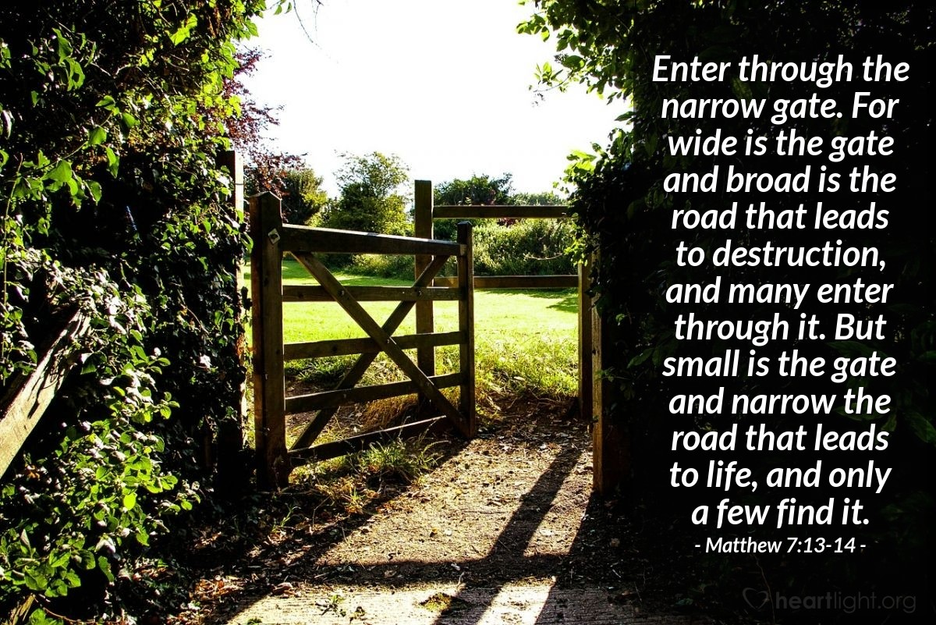
CHRIST THE ROCK CONGREGATION
SUNDAY DECEMBER 11TH 2022
Sermon by Pastor
MARC E SIMEON
THE NARROW GATE TO GET TO GOD

Slide 2
THE NARROW GATE TO GET TO GOD
Mt 7:13-14 "Enter by the narrow gate; for wide is the gate and broad is the way that leads to destruction, and there are many who go in by it.
14 "Because narrow is the gate and difficult is the way which leads to life, and there are few who find it.

Slide 3
INTRODUCTION
During the pandemic, the world has become familiar with the definition of narrow gate.
People became overtly conscious to prevent the spread of the corona virus.
Many establishments created a tight access point to their buildings.
You had to fill and sign the screening sheet to get access in some places.

Slide 4
Someone would actually check your body temperature before letting you in.
It went further, if someone in one’s house was infected; everyone in that address had to be tested negative before going back to work.
Traveling by air became a big burden.
In some cases, you had to have a covid negative certificate to board in.

Slide 5
I went to a graduation in the midst of the pandemic era, it was a mess.
Everyone had to be pre-registered and the lines were very long to get to the arena where the graduation was taking place.
All of these measures were justified although many were at odds with them, because it was for a worthy cause.

Slide 6
Heaven is a place of complete holiness; no sin can penetrate in the holy city of God.
All of the habitants of the earth sons of Adam are infected with the sin disease.
The only ones who can enter in heaven are those who were properly vaccinated by the blood of Jesus.
No unvaccinated human being can enter to heaven, by that I mean the cleansing blood of Jesus vaccine.

Slide 7
People who truly want to go to heaven will have to pass through the narrow gate.
The gate of heaven is so narrow that two people cannot go through it at a time.
The gate of heaven is so narrow that you cannot even get through with your luggage.

Slide 8
To get through the gate of heaven, you have to be at bare.
There are many alternate gates out there but none of them leads to heaven.
With that, I want to consider another parable of Jesus to lay the foundation for my message today.

Slide 9
The Parable of the Wedding Banquet
MAT 22:1-14
1 Jesus spoke to them again in parables, saying:
² “The kingdom of heaven is like a king who prepared a wedding banquet for his son.
³ He sent his servants to those who had been invited to the banquet to tell them to come, but they refused to come.

Slide 10
⁴ “Then he sent some more servants and said, ‘Tell those who have been invited that I have prepared my dinner: My oxen and fattened cattle have been butchered, and everything is ready. Come to the wedding banquet.’
⁵ “But they paid no attention and went off—one to his field, another to his business.
⁶ The rest seized his servants, mistreated them and killed them.

Slide 11
⁷ The king was enraged. He sent his army and destroyed those murderers and burned their city.
⁸ “Then he said to his servants, ‘The wedding banquet is ready, but those I invited did not deserve to come.
⁹ So go to the street corners and invite to the banquet anyone you find.’
¹⁰ So the servants went out into the streets and gathered all the people they could find, the bad as well as the good, and the wedding hall was filled with guests.

Slide 12
¹¹ “But when the king came in to see the guests, he noticed a man there who was not wearing wedding clothes.
¹² He asked, ‘How did you get in here without wedding clothes, friend?’ The man was speechless.
¹³ “Then the king told the attendants, ‘Tie him hand and foot, and throw him outside, into the darkness, where there will be weeping and gnashing of teeth.’

Slide 13
¹⁴ “For many are invited, but few are chosen.”
Here again we see an invitation followed by the rejection of the first invitees.
Another set of invitations was launched and the respond was great, yet there was a shameful ejection of one guest.

Slide 14
THE BANQUET
There are many ways to get to a paid or check-in event.
You can wait for someone to open the back door and sneak ii without being noticed.
You can get in through the windows or somehow through the roof.
You can pretend to be a staff and walk right in.

Slide 15
You can wait outside and swap places with someone who looks just like you.
Or, you can purchase the ticket and access in through the front door or the check-in access point.
Or you can present your invitation card and wait to be seated.

Slide 16
If you chose a fraudulent way to get to the event, you run the risk of getting caught and put to shame.
With all the scrutiny involved to get to the White House, some often manage to get to some events uninvited.
In the parable of the wedding banquet we find several details that need specific attentions.

Slide 17
A parable usually conveys one central message, but this parable has a multifold of messages.
In Matthew 22, the parable ends with someone being thrown out for misconduct.

Slide 18
THE FIRST INVITATION
We understand that the first invitees were the people of the Jewish nation.
He came to His own and His own received him not.
They gave a vague and cruel response to the invitation of God.
Some gave all sorts of excuses for their absences.

Slide 19
Others even kill the messengers to get the king angry.
Their responses to the invitation have caused the king to destroy that city and all its inhabitants.
The Jewish people are the rightful heirs of the Kingdom of God due to the alliance God made with Abraham.

Slide 20
Jesus is their awaited Messiah although they failed to recognize that.
A great judgment fell upon them for the way they treated Jesus the only Begotten Son of God.

Slide 21
THE SECOND INVITATION
Another wave of invitation was launched in the parable. This time the invitation was broad and unrestrictive.
All who wanted could attend the banquet.
The king wanted for the banquet to be packed with people.

Slide 22
The broadness of the invitation had lead one guest to think that the standard of the banquet would be lowered.
The contrary was true.
The king expected the same high etiquette from all who attended the banquet.

Slide 23
THE NARROW GATE TO THE BANQUET
Missing from the parable is the front door operation.
There must have been a front door to check in those guests who were just picked from the side of the road.
There must have been a shower room to send these wild guests in before letting them enter the banquet room.

Slide 24
There must have been a salon to cut the air of these not so fancy guests.
There must have been a dressing room, where the new last minute guests to change their old garments to the fitly garments of the banquet.
There must have been a last inspection point before the guests could access to the banquet room.

Slide 25
The feast must have cost the king three times the amount of money to salvage the new wave of guest to the prestige of the occasion.
That’s why the king was so furious with the improperly clothed man.

Slide 26
THE DISGRACED GUEST AT THE WEDDING BANQUET
¹¹ “But when the king came in to see the guests, he noticed a man there who was not wearing wedding clothes.
¹² He asked, ‘How did you get in here without wedding clothes, friend?’ The man was speechless.

Slide 27
How did you get here without the proper attire the king asked?
Who let you in?
Who gave you the pass?
Did you get in through the front door?
How did you end up in the banquet?
Didn’t they specify what kind of gathering it was.

Slide 28
GOD’S PARTY, GOD’S RULE
There are some who hate rules.
Everything has to be done their own way.
Although there was obviously a process put in place, this man tried to bypass the system to get to the banquet.
There are those who want to partake in God’s banquet with their filthy clothes of sin on.

Slide 29
They refuse the process of regeneration.
They refuse to crucify their sin nature for the benefit regenerated souls.
They want God to lower the standard so that they fit in as is.
Since there was no discrimination in the last invitation, expectedly, both good and bad people attended the banquet.

Slide 30
It is logical that some of the guests would have criminal backgrounds.
Some of the guests would be prostitutes, murderers, con artists, adulterers, homosexuals, pedophiles, thieves, etc.
Some of the guests would be struggling with all sorts of addictions.
No matter what state the guest arrives, the front office of salvation is equipped to deal with it.

Slide 31
The Holy Spirit is not a makeup artist bur a regeneration artist.
In some shows the makeover process may involve dentist, cosmetic surgeons, clothe designers, hair dressers, nails dressers, fitness expert, and the list goes on.
God is ready to give each and every guess who responds to His invitation a complete makeover to make them fit for the occasion.

Slide 32
The Holy Spirit is busy preparing us for the day of the Lord.
The rejection will occur when the king steps in the banquet.
Everyone might have given you an ok pass, but the opinion of the King is final.
Many denominations are busy selling tickets to God’s banquet.They lower the standard for their own survival because they make profit on those sales.

Slide 33
Do not rest the assurance of your salvation on the bylaws of your church or denomination.
God’s word is the only standard for salvation.
In the name of love and acceptance, many churches are passing out fake ticket of salvation.
The banquet will not take place in your church auditorium but in the kingdom of God.

Slide 34
The kingdom of God is completely sealed of sin.
God would never go against His word.
God has never updated the requirements of His kingdom to adhere to the bents of the present generations.
If anyone tells you that you can live a life of sin and still get to heaven without a genuine repentance, they lied to you.

Slide 35
One day, it will just be you in the presence of the Holy God and no one else.
Your eternal destiny will be decided at once by God.
Either to remain in the King’s banquet or to be thrown out to an eternity of anguish will be decided by God.
Remember that holiness was the determining factor in that parable.

Slide 36
That man was in a banquet that required a high etiquette.
The attire he had on insulted the king.
Mt 7:13 "Enter by the narrow gate; for wide is the gate and broad is the way that leads to destruction, and there are many who go in by it.
14 "Because narrow is the gate and difficult is the way which leads to life, and there are few who find it.

Slide 37
CONCLUSION
Remember that this parable was given with the gentiles in mind.
We were not the first invitees to God’s banquet, the Jewish people were.
By their rejection to the invitation, God crafted a plan for all mankind to partake in the plan of salvation.

Slide 38
Remember that the fact that all sorts of people were invited does not lower the high etiquette required of God’s banquet.
If God had not spared the real invitees who neglected his invitation, nor will he spare you if you refuse to adhere to the rules of the banquet.
Remember that it was the king who ordered the non-compliant guest to be thrown out, not the one who let him in and told him he was ok.

Slide 39
You can come to God as you are, but you cannot remain with God as you were.
Sanctification is a threefold process.
You are first accepted in the admission office to sign the salvation contract for a change of nature by which you can begin the Christian journey.
In the package, you accepted for Jesus to be Lord over your life in exchange for salvation.

Slide 40
The next and hardest phase of the program is the daily sanctification process.
That is where many people drop out.
Those who persevere in the program will be rewarded.
The last phase of God’s program is graduation or glorification.

Slide 41
Glorification starts the day you die and those who are still alive, at the rapture of the saints.
Remember what Mat 22: 14 says, “For many are invited, but few are chosen.”
Although the whole human race is invited, make sure to be among the chosen.
AMEN!

