Slide 1
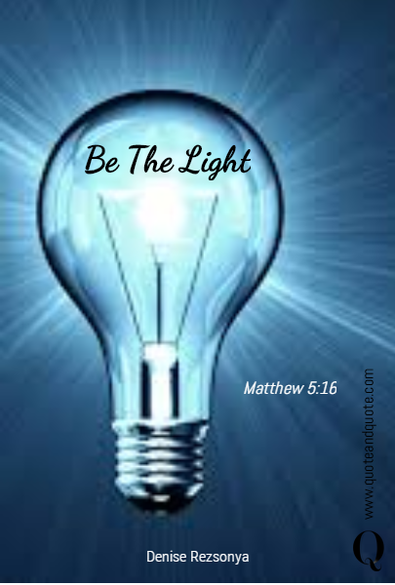
CHRIST THE ROCK CONGREGATION
SUNDAY NOVEMBER 13TH 2022
Sermon by Pastor
MARC E SIMEON
YOU ARE THE LIGHT OF THE WORLD

Slide 2
Matthew 5:14-16
Mt 5:14 "You are the light of the world. A city that is set on a hill cannot be hidden.
15 "Nor do they light a lamp and put it under a basket, but on a lampstand, and it gives light to all who are in the house.
16 "Let your light so shine before men, that they may see your good works and glorify your Father in heaven.

Slide 3
INTRODUCTION
In Matthew 5 commonly known as the Sermon on the Mount, Jesus places several lines of distinction between the Christian and the non-Christian.
Last week we saw that we are the salt of this tasteless world we live in.
Jesus warns us to maintain our saltiness, meaning our faith, our testimony, and our positive influence toward the people of this world.

Slide 4
If we allow our taste to be faded away, shame and rejection will follow.
This week, we are seeing another allegory of Jesus picturing Christians as the light of this world.
By implication, this world is a place of complete spiritual darkness.
The world was not always a place of darkness, but when mankind fell in sin, the whole physical world became doomed as a result.

Slide 5
Christians represent the only ray of light to guide the inhabitants of this world back to God.
If you live in a developing country, it’s hard to imagine the effect of the absence of light during the night.
Even in the most remote regions of the earth, the sky is usually illuminated by the brightness of the stars and the moon during the night.

Slide 6
When I was growing up a flash light was always within reach at night.
We had a donkey during vacation time it was usually my responsibility to untie the donkey and bring him to the nearby river to drink water during the day.
Carried away with having fun, I often forgot to care for the donkey.

Slide 7
When my dad comes back from work sometimes real late at night, he always asked me if I took care of the donkey, whether I say yes or no, he would still go and check on the donkey, so I always have to say the truth to avoid further consequences.
Every now and then his reply would be, we’re going right now.
You can tell how much I hated that donkey.

Slide 8
I would walk in front of my father in peach darkness going through the woods to get to the donkey.
My biggest punishment would be when my father decides to turn off the flashlight just for the fun of it.
I was never amused of that.
I would beg him to whoop me if he wishes instead of turning off the flashlight.

Slide 9
It felt like all the trees turn to monsters at night.
That used to be the most horrifying moments in my childhood, all because of my fear of darkness.
Imagine a world with no sun and no moon and no stars, no day time, just darkness all the time.
In a world of complete darkness, light becomes the most craved for element for navigation, for security, for cooking, for reading, for safety, etc.

Slide 10
In John chapter 1, Jesus is stated to be the light that came to the world coming from God, but the world preferred the darkness.
Joh 3:19 And this is the judgment, that the light has come into the world, and men loved darkness rather than light, because their deeds were evil.

Slide 11
20 For every one who does evil hates the light, and does not come to the light, lest his deeds should be exposed.
21 But he who does what is true comes to the light, that it may be clearly seen that his deeds have been wrought in God.

Slide 12
CHRISTIANS ARE THE LIGHT OF THIS WORLD
When we become Christians, we share the divine nature of Christ; we become light just like Jesus.
Jesus says to his disciples, “you are the light of the world.”
Meaning, that the world will be looking up to you for orientation, for truth, for illumination, for enlightenment and for a sense of purpose.

Slide 13
John 8:12: When Jesus spoke again to the people, he said, "I am the light of the world. Whoever follows me will never walk in darkness, but will have the light Joh 12:36 While you have the light, believe in the light, that you may become sons of light."
Eph 5:8-9 for once you were darkness, but now you are light in the Lord; walk as children of light 9 (for the fruit of light is found in all that is good and right and true),

Slide 14
1Th 5:5 For you are all sons of light and sons of the day; we are not of the night or of darkness.
Light and darkness cannot be mixed.
Light must overcome darkness.
Light eliminates darkness.
Light must shine to chase away darkness.
Light must be placed above to overshadow the darkness.
Light must be exposed.
Light must lead the way.

Slide 15
THE TEST OF AUTHENTICITY OF THOSE WHO ARE IN THE LIGHT
1Jo 2:9 He who says he is in the light and hates his brother is in the darkness still.
10 He who loves his brother abides in the light, and in it there is no cause for stumbling.
11 But he who hates his brother is in the darkness and walks in the darkness, and does not know where he is going, because the darkness has blinded his eyes.

Slide 16
Mt 6:23 "But if your eye is bad, your whole body will be full of darkness. If therefore the light that is in you is darkness, how great is that darkness!
Being in the light is not an empty statement but it must be evidenced in your deed.
What you do, what you listen to, what you watch, how you think, what you believe, what you approve or disapprove must be in line with the light.

Slide 17
BENEFITS OF BEING IN THE LIGHT
Mt 5:14 "You are the light of the world. A city that is set on a hill cannot be hidden.
15 "Nor do they light a lamp and put it under a basket, but on a lampstand, and it gives light to all who are in the house.
Light yields energy.
Light provides clarity.

Slide 18
Light gives direction.
Light protects from danger.
Light display beauty
Light reveals the truth
Light cancels out fear
Light protects from intruders.
Light chases away thieves and criminals.
Light renders darkness powerless
Light favors the truth.

Slide 19
LIGHT MUST SHINE AND NOT BE SHY
Mat 5:16 "Let your light so shine before men, that they may see your good works and glorify your Father in heaven.
Hidden light is of no effect to its environment .
The very purpose of light is to shine.

Slide 20
Light doesn’t care about what darkness thinks of it.
Light is not worried about standing alone.
Light prides itself of its uniqueness and the services it renders to others.

Slide 21
BE AWARE THAT LIGHT IS NOT LOVED BY ALL
John 3:19-21
19 And this is the judgment, that the light has come into the world, and men loved darkness rather than light, because their deeds were evil.
20 For every one who does evil hates the light, and does not come to the light, lest his deeds should be exposed.

Slide 22
21 But he who does what is true comes to the light, that it may be clearly seen that his deeds have been wrought in God.
There are people who prefer darkness over the light because of the nature of their deeds.
Thieves hate light.
Criminals hate lights.
Rodents hate light
Darkness is a safe haven for all sorts of sinners.

Slide 23
CONCLUSION
God is glorified when His children walk in the light, because God is the source of their lights.
The brilliance of your light indicates the level of your intimacy with God.
God is very proud with all of His children who are making the effort to walk in the light in this generation of darkness.

Slide 24
Your light will prevent the darkness to take over.
You may not be able to illuminate the whole world, but try to brighten your country.
If your light cannot cover the whole country, try to brighten your State.
If your light is not enough to cover the whole state, try to brighten your city.

Slide 25
If you cannot reach the whole city with your light, try to brighten your neighborhood, your street, if not, then, brighten your own house as a start.
YOU ARE THE LIGHT OF THIS WORLD AND GOD IS COUNTING ON YOU TO SHINE WHEREVER YOU ARE!
AMEN!

