Slide 1

CHRIST THE ROCK CONGREGATION
PRÉSENTE
ÉTUDIONS LA BIBLE
VENDREDI 19 AOUT 2022
ETUDE BIBLIQUE 22èME SESSION
L’ARRIVÉ DE JACOB A CHARAN CHEZ SON ONCLE LABAN
THE ARRIVAL OF JACOB AT CHARAN AT THE HOUSE OF LABAN

Slide 2
VERSET DU JOUR
Genèse 29 :11
Ge 29:11 Et Jacob baisa Rachel, il éleva la voix et pleura.
11 Then Jacob kissed Rachel, and lifted up his voice and wept.

Slide 3
PRIERE
INTRODUCTION
Matière du jour
THE ARRIVAL OF JACOB AT CHARAN AT THE HOUSE OF LABAN
L’ARRIVÉ DE JACOB A CHARAN CHEZ SON ONCLE LABAN

Slide 4
What verdict King Salomon pronounced that made him famous for his wisdom?
Which son of David caused him to flee away from Jerusalem to save his life?
Who prayed and the earth opened up and swallowed his opponents?

Slide 5
4. What is the name of the High priest who died when he heard that the Arch of the Covenant was seized by the enemies and that his two sons also died in the process?
5. What was Jesus’ first recorded miracle?
6- Who was a thief among the disciples of Jesus?
7- Name the two great missionary partners who got separated after a big fight?

Slide 6
8- What were the economic and spiritual conditions of the church of Smyrna?
9- What is a eunuch?
10- Who warned Pilate to dismiss himself from the case of Jesus?

Slide 7
THE ARRIVAL OF JACOB AT CHARAN AT THE HOUSE OF LABAN
L’ARRIVÉ DE JACOB A CHARAN CHEZ SON ONCLE LABAN
INTRODUCTION
We’ve been following the story of Jacob in the few weeks.
Although Jacob was a man of destiny, we see that nothing in life came easy for him.

Slide 8
Jacob left home with a lot of uncertainties in his heart.
People of destiny are always restless until they hit the center of God’s will for their lives.
Everything Jacob had done thus far was propelled by pressure and odd circumstances.
The departure from his father was circumstantial move.

Slide 9
Yet, all the events in the lives of Jacob were orchestrated by God.
God led him in the wilderness so that He could have a one on one with Jacob.
Although Jacob was covered in the alliance of Abraham, he also had to sign his own contract with God.

Slide 10
When God met Jacob in the wilderness, He already knew where Jacob was heading.
God already promised Jacob a safe arrival and a safe return to Canaan.
That prophecy covered for a span of 20 years.

Slide 11
Jacob promised to God to be a faithful devotee of Him if he keeps all His promises.
The human element is still with us even if we’ve had the most sublime encounter with God.
Jacob kept his pace toward Padan-Aram not knowing what the future held for him.

Slide 12
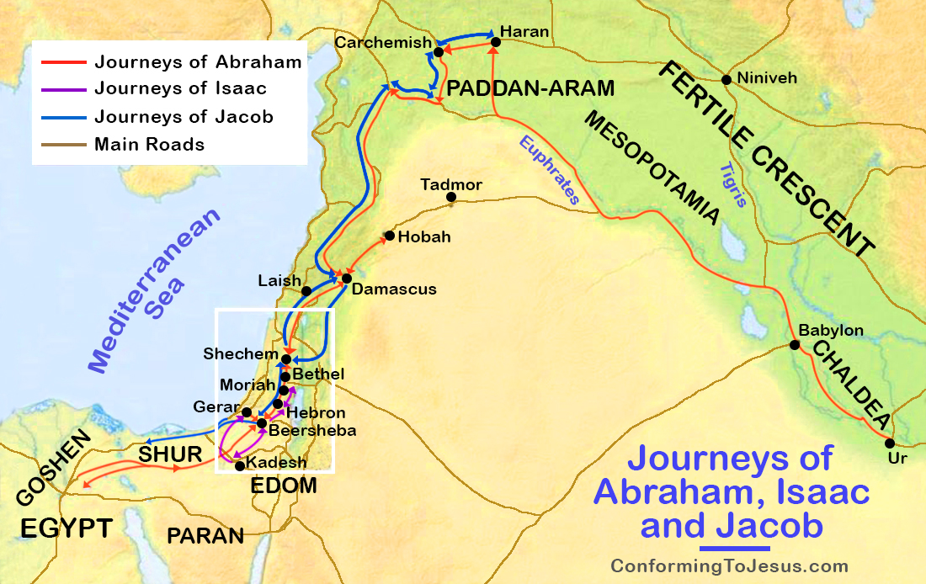

Slide 13
MIRACULOUS MEEETING BETWEEN JACOB AND LABAN
This portion of the story of the life of Jacob is like a déjà-vu.
Some 40 plus years earlier, Eliezer took the same direction top look for a wife for Isaac.
Although Eliezer would have loved to land at the house of Bethuel, but the providence of God orchestrated that Rebecca was chosen.

Slide 14
This time it is Rebecca’s son who took the journey for a dual purpose of safety and search for a bride.
Jacob is about to meet the love of his life in the same manner her mother was met.
Ge 29:1-11 ¶ Jacob se mit en marche, et s'en alla au pays des fils de l'Orient.

Slide 15
2 Il regarda. Et voici, il y avait un puits dans les champs; et voici, il y avait à côté trois troupeaux de brebis qui se reposaient, car c'était à ce puits qu'on abreuvait les troupeaux. Et la pierre sur l'ouverture du puits était grande.
3 Tous les troupeaux se rassemblaient là; on roulait la pierre de dessus l'ouverture du puits, on abreuvait les troupeaux, et l'on remettait la pierre à sa place sur l'ouverture du puits.

Slide 16
4 Jacob dit aux bergers: Mes frères, d'où êtes-vous? Ils répondirent: Nous sommes de Charan.
5 Il leur dit: Connaissez-vous Laban, fils de Nachor? Ils répondirent: Nous le connaissons.
6 Il leur dit: Est-il en bonne santé? Ils répondirent: Il est en bonne santé; et voici Rachel, sa fille, qui vient avec le troupeau.

Slide 17
7 Il dit: Voici, il est encore grand jour, et il n'est pas temps de rassembler les troupeaux; abreuvez les brebis, puis allez, et faites-les paître.
8 Ils répondirent: Nous ne le pouvons pas, jusqu'à ce que tous les troupeaux soient rassemblés; c'est alors qu'on roule la pierre de dessus l'ouverture du puits, et qu'on abreuve les brebis.

Slide 18
9 ¶ Comme il leur parlait encore, survint Rachel avec le troupeau de son père; car elle était bergère.
10 Lorsque Jacob vit Rachel, fille de Laban, frère de sa mère, et le troupeau de Laban, frère de sa mère, il s'approcha, roula la pierre de dessus l'ouverture du puits, et abreuva le troupeau de Laban, frère de sa mère.
11 Et Jacob baisa Rachel, il éleva la voix et pleura.

Slide 19
Fear keeps us from trusting God wholeheartedly.
Only God could arrange for Jacob and Rachel to be spotted at the same time in that geographical location.
God makes all the most difficult things that worry us to look easy.
Jacob could not believe the precision of God.

Slide 20
There no such things like coincidence in life.
Most of what we call coincidence is usually the work of God.
Jacob could no longer hold his emotion.
Laban is alive.
Laban has a beautiful, hard working daughter just like her mother was.

Slide 21
Rachel was very welcoming just like Rebecca was.
Jacob was already at work to help Rachel with the sheep.
If people had more faith in God to take more journeys throughout their lives, they would discover the rest of their destiny.

Slide 22
Gen 29:12 Jacob apprit à Rachel qu'il était parent de son père, qu'il était fils de Rebecca. Et elle courut l'annoncer à son père.
13 Dès que Laban eut entendu parler de Jacob, fils de sa sœur, il courut au-devant de lui, il l'embrassa et le baisa, et il le fit venir dans sa maison. Jacob raconta à Laban toutes ces choses.
14 Et Laban lui dit: Certainement, tu es mon os et ma chair. Jacob demeura un mois chez Laban.

Slide 23
THE WELCOME OF LABAN
Not all families are created equals.
The sweetness ran in Abraham’s family.
From what I understand, God had been working in that family for a long time although they were pagans gods worshipers.

Slide 24
Laban loved his sister Rebecca very much.
Laban was very protective of Rebecca.
The separation of Laban and Rebecca was very emotional.
Laban wanted to hold Rebecca back for another 15 days.

Slide 25
This is how Laban and the others blessed Rebecca when she was leaving.
Ge 24:60 Ils bénirent Rebecca, et lui dirent: O notre soeur, puisses-tu devenir des milliers de myriades, et que ta postérité possède la porte de ses ennemis!

Slide 26
Upon hearing that the son of Rebecca was in town, Laban was very excited.
That is the first news she had of them since she left.
Jacob did not have to wonder one more day.
Upon arrival, he was given a place to live and a place to work.

Slide 27
LE DEBUT DE LA VIE FAMILIALE DE JACOB
Gen 29:15-30
15 ¶ Puis Laban dit à Jacob: Parce que tu es mon parent, me serviras-tu pour rien? Dis-moi quel sera ton salaire.
16 Or, Laban avait deux filles: l'aînée s'appelait Léa, et la cadette Rachel.

Slide 28
17 Léa avait les yeux délicats; mais Rachel était belle de taille et belle de figure.
18 Jacob aimait Rachel, et il dit: Je te servirai sept ans pour Rachel, ta fille cadette.
19 Et Laban dit: J'aime mieux te la donner que de la donner à un autre homme. Reste chez moi!

Slide 29
20 Ainsi Jacob servit sept années pour Rachel: et elles furent à ses yeux comme quelques jours, parce qu'il l'aimait.
21 Ensuite Jacob dit à Laban: Donne-moi ma femme, car mon temps est accompli: et j'irai vers elle.
22 Laban réunit tous les gens du lieu, et fit un festin.

Slide 30
23 Le soir, il prit Léa, sa fille, et l'amena vers Jacob, qui s'approcha d'elle.
24 Et Laban donna pour servante à Léa, sa fille, Zilpa, sa servante.
25 Le lendemain matin, voilà que c'était Léa. Alors Jacob dit à Laban: Qu'est-ce que tu m'as fait? N'est-ce pas pour Rachel que j'ai servi chez toi? Pourquoi m'as-tu trompé?

Slide 31
26 Laban dit: Ce n'est point la coutume dans ce lieu de donner la cadette avant l'aînée.
27 Achève la semaine avec celle-ci, et nous te donnerons aussi l'autre pour le service que tu feras encore chez moi pendant sept nouvelles années.
28 Jacob fit ainsi, et il acheva la semaine avec Léa; puis Laban lui donna pour femme Rachel, sa fille.

Slide 32
29 Et Laban donna pour servante à Rachel, sa fille, Bilha, sa servante.
30 Jacob alla aussi vers Rachel, qu'il aimait plus que Léa; et il servit encore chez Laban pendant sept nouvelles années.
We often talk about the polygamous life of Jacob, but Jacob did not make the choice, it was enforced on him.

Slide 33
Jacob worked seven years for free as dot payment in exchange for the girl he loved.
On the wedding day, Laban slipped in Lea.
Can you imagine the confusion in that next morning in that honeymoon?
Jacob rightfully complained about the trick.
Now, he is indebted to work another seven years.

Slide 34
He so loved Rachel that he was willing to do whatever the sacrifice necessary to be with her.
He did not have to wait seven years to get Rachel, but he had to work another seven years for free.
Some girls deserve for a man to labor fourteen years in order to be with her. Some but not all.

Slide 35
Gen 29:31 ¶ L'Éternel vit que Léa n'était pas aimée; et il la rendit féconde, tandis que Rachel était stérile.
32 Léa devint enceinte, et enfanta un fils, à qui elle donna le nom de Ruben; car elle dit: L'Éternel a vu mon humiliation, et maintenant mon mari m'aimera.
33 Elle devint encore enceinte, et enfanta un fils, et elle dit: L'Éternel a entendu que je n'étais pas aimée, et il m'a aussi accordé celui-ci. Et elle lui donna le nom de Siméon.

Slide 36
34 Elle devint encore enceinte, et enfanta un fils, et elle dit: Pour cette fois, mon mari s'attachera à moi; car je lui ai enfanté trois fils. C'est pourquoi on lui donna le nom de Lévi.
35 Elle devint encore enceinte, et enfanta un fils, et elle dit: Cette fois, je louerai l'Éternel. C'est pourquoi elle lui donna le nom de Juda. Et elle cessa d'enfanter.

Slide 37
Here again, we see how God is intertwined even in the imperfection of mankind to bring out his will.
The dysfunctional family of Jacob had enough foreign elements in it for a specific purpose.
The two wives of Jacob were in the same family tree of Abraham.

Slide 38
The two concubines of Jacob were foreigners.
God intentionally allowed that to happen so that all races could be present in the nations of Israel.
The nation of Israel was never intended to be homogenous in texture or skin color.
Lea was trying in vain to win the love of Jacob.

Slide 39
Sometimes we waste our time thinking that we can make people love us by performance.
Although Rachel was barren for many years, Lea was never able to change the trajectory of the affection of Jacob toward her.
Quit trying to play those silly games.

Slide 40
CONCLUSION
We see clearly that God uses imperfect people like Jacob, like you and me to foster his will.
We see that God can use even the wrongs that you endure from others as a stepping stone to launch you toward your destiny.
We also see how deception played a big role in the lives of the people in the time of Jacob.

Slide 41
Next week God willing we will the end of Jacob’s sojourn in Charan.
Jacob will have to make a decisive return trip to his homeland.
A person of destiny must be willing to sail whenever the wind blows toward his God given mission in life.
Jacob will again make people mad by his departure from Charan.
AMEN!

Slide 42
What verdict King Salomon pronounced that made him famous for his wisdom? (The women with the dead child)
Which son of David caused him to flee away from Jerusalem to save his life? (Absalon)
Who prayed and the earth opened up and swallowed his opponents? (Moses)

Slide 43
4. What is the name of the High priest who died when he heard that the Arch of the Covenant was seized by the enemies and that his two sons also died in the process? (Eli)
5. What was Jesus’ first recorded miracle?
(water unto wine)
6- Who was a thief among the disciples of Jesus? (Judas)

Slide 44
7- Name the two great missionary partners who got separated after a big fight?(Barnabas and Paul)
8- What were the economic and spiritual conditions of the church of Smyrna? (poor, persecuted, but faithful to God)
9- What is a eunuch? (man castrated for service)
10- Who warned Pilate to dismiss himself from the case of Jesus? (his wife)

Slide 45
Format des rencontres :
Chaque vendredi de 7 :30 a 9 :00 PM
YouTube Presentation 7:30-8:30pm
Conference call opens at 8:30pm for questions and comments (774) 217 6502
You can also text your questions to me at (617) 291 3559

Slide 46
ANNOUNCEMENTS
  (Mon, Wed) 7:30-9:30PM PRAYER MEETING LINE # (774) 217 6502
  FRIDAY: 7:30-9:00pm-----Bible Study (YOU TUBE)
  SATURDAY
  10:00 -11:30 AM-----CTRC MEN ( MEETING)
  3:00-500PM--------------CTRC YOUTH (zoom)
  3:00-4:30 PM-----GAITE ENFANTINE (IN CHURCH/ zoom)
  6:00-8:00PM--------CTRC LADIES # (774) 217 6502
  STEM FOR ALL BROCKTON

Slide 47
PRIÈRE FINALE
BENEDICTIONS

