Slide 1

CHRIST THE ROCK CONGREGATION
PRÉSENTE
ÉTUDIONS LA BIBLE
VENDREDI 12 AOUT 2022
ETUDE BIBLIQUE 21èME SESSION
PAR PASTEUR MARC SIMÉON
LE PREMIER VOYAGE DE JACOB

Slide 2
VERSET DU JOUR
Ge 28:16 ¶ Then Jacob awoke from his sleep and said, "Surely the LORD is in this place, and I did not know it."
16 ¶ Jacob s'éveilla de son sommeil et il dit: Certainement, l'Éternel est en ce lieu, et moi, je ne le savais pas!

Slide 3
PRIERE
INTRODUCTION
Matière du jour
LE PREMIER VOYAGE DE JACOB
THE FIRST JOURNEY OF JACOB

Slide 4
Who allowed Jesus to use his boat to preach after having spent all night fishing with no catch?
To how many parties Esther invited the king and Haman before making known her request?
Who asked to be called Mara when she returned to Israel because of all her misfortune in life?
Who died instantly for having touched the Arch of the Covenant?

Slide 5
5- What happened to the first tablets of the Commandments that Moses brought down from the mountain?
6- In what occasion a divine hand began writing on a wall in Daniel’s time?
7- What is the name of the place where Jesus prayed his last prayer with some disciples before the crucifixion?

Slide 6
8- In what way the Shunammite woman extended her hospitality to Prophet Elisha and his servant?
9- Where is this verse located? "Behold, I stand at the door and knock. If anyone hears My voice and opens the door, I will come in…
10- Why were the three young Hebrews thrown in the fiery furnace?

Slide 7
ETUDE BIBLIQUE 21EME SESSION
PAR PASTEUR MARC SIMÉON
LE 1ER VOYAGE DE JACOB
THE FIRST JOURNEY OF JACOB

Slide 8
RECAP
In the last few weeks, we’ve introduced to you the man in question in this series of Bible study.
Jacob needs no more introductions for those who’ve followed our lessons in the last few weeks.
Jacob as we said it was a man of destiny
We zeroed on the birth of Jacob

Slide 9
The rivalry between Jacob and Esau
The deceptions of Jacob
The invisible hands of God in the life of Jacob
We stopped at the point where Jacob was about to leave father’s house
That too had some deceptions in it

Slide 10
INTRODUCTION
The human element is so vivid in the story Jacob that it may obscure to the view the mighty intervention of God.
We are preparing to take the first journey with Jacob.
There are lies and tricks involved in that one also as we mentioned.

Slide 11
Rebecca saw that this schism between her two sons were about to turn bloody.
Her mother’s instinct kicked in; she had to come up with a plan to get her beloved son out of the situation.
Remember that we are talking about a blind husband and a smart woman who is determined to get her way at all cost.

Slide 12
Genèse 28:1-5
1 ¶ Isaac appela Jacob, le bénit, et lui donna cet ordre: Tu ne prendras pas une femme parmi les filles de Canaan.
2 Lève-toi, va à Paddan-Aram, à la maison de Bethuel, père de ta mère, et prends-y une femme d'entre les filles de Laban, frère de ta mère.

Slide 13
3 Que le Dieu tout-puissant te bénisse, te rende fécond et te multiplie, afin que tu deviennes une multitude de peuples!
4 Qu'il te donne la bénédiction d'Abraham, à toi et à ta postérité avec toi, afin que tu possèdes le pays où tu habites comme étranger, et qu'il a donné à Abraham!
5 Et Isaac fit partir Jacob, qui s'en alla à Paddan-Aram, auprès de Laban, fils de Bethuel, l'Araméen, frère de Rebecca, mère de Jacob et d'Ésaü.

Slide 14
The first journey was more a running away than a planed adventure.
Nonetheless, it was an important journey.
Nonetheless, it was a journey of destiny.
Nonetheless it was an obligatory journey.

Slide 15
There are puzzles in one’s destiny that will never be discovered except in a journey.
Jacob was full of fear and doubt on his first journey, but he had no chance but to take it.
The first journey of Jacob seemed risky and vague, but it was precisely in the will of God.

Slide 16
THE JOURNEYS OF OUR LIVES
There are times in life, when it becomes essential for each person to take a journey.
A journey offers a new perspective
A journey offers a new exposure
A journey offers a chance for a new adventure

Slide 17
A journey offers a chance to start over
A journey offers an escape from the territorial demons that have been threatening one’s life.
A journey offers a chance to emancipate.
A journey offers a chance for independence.

Slide 18
A journey offers a chance for a self-discovery.
A journey offers a chance to catch-up with one’s purpose and assignment in life.
A journey offers a chance to enhance one’s intimacy with God
A journey offers a chance for one to choose his environment, his friends, and his family.

Slide 19
A journey offers a chance to disassociate oneself from some old acquaintances who would otherwise be toxic and detrimental to one’s future
A journey offers the chance to remove oneself from the clutches of over- domineering parents and family members.

Slide 20
THE FIRST JOURNEY OF JACOB
The first journey of Jacob affords him a close encounter with God that could not have happened in any other way.
Jacob was introduced to the spiritual world.
Ge 28:10-19 ¶ Jacob partit de Beer-Schéba, et s'en alla à Charan.
11 Il arriva dans un lieu où il passa la nuit; car le soleil était couché. Il y prit une pierre, dont il fit son chevet, et il se coucha dans ce lieu-là.

Slide 21
12 Il eut un songe. Et voici, une échelle était appuyée sur la terre, et son sommet touchait au ciel. Et voici, les anges de Dieu montaient et descendaient par cette échelle.
13 Et voici, l'Éternel se tenait au-dessus d'elle; et il dit: Je suis l'Éternel, le Dieu d'Abraham, ton père, et le Dieu d'Isaac. La terre sur laquelle tu es couché, je la donnerai à toi et à ta postérité.

Slide 22
14 Ta postérité sera comme la poussière de la terre; tu t'étendras à l'occident et à l'orient, au septentrion et au midi; et toutes les familles de la terre seront bénies en toi et en ta postérité.
15 Voici, je suis avec toi, je te garderai partout où tu iras, et je te ramènerai dans ce pays; car je ne t'abandonnerai point, que je n'aie exécuté ce que je te dis.

Slide 23
16 ¶ Jacob s'éveilla de son sommeil et il dit: Certainement, l'Éternel est en ce lieu, et moi, je ne le savais pas!
17 Il eut peur, et dit: Que ce lieu est redoutable! C'est ici la maison de Dieu, c'est ici la porte des cieux!

Slide 24
18 Et Jacob se leva de bon matin; il prit la pierre dont il avait fait son chevet, il la dressa pour monument, et il versa de l'huile sur son sommet.
19 Il donna à ce lieu le nom de Béthel; mais la ville s'appelait auparavant Luz.

Slide 25
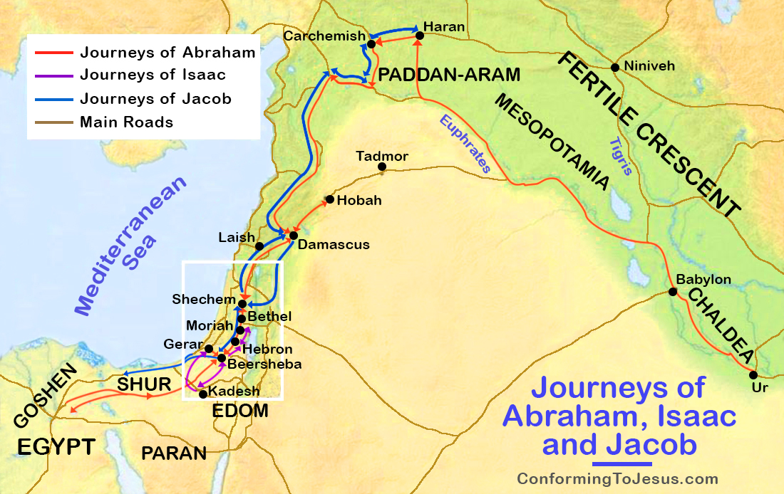

Slide 26
All journeys are risky, all journeys involve doubts
Jacob was reassured that he was on God’s GPS
It is as if God was telling Jacob, “Nothing in your life so far has happened by accident.”
Abraham the forefather of the Jewish nation has had his personal encounter with God

Slide 27
Isaac one the patriarch of the nation of Israel has had his own revelation
This time it is Jacob’s turn.
There is no more doubt, there is no more running away
The partnership, the covenant between Jacob and God had been officially established.

Slide 28
KEY ELEMENTS IN THE PROPHECY
God is real
God has chosen Jacob and has made a covenant with him.
God will give the land of Canaan to the descendants of Abraham.
Jacob will have a safe journey to Paddan-Aram.
Jacob will prosper in that land.

Slide 29
Jacob will return back in the land of Canaan safe and sound.
Jacob had made the first execution as heir of the land, when he declared: This will be called Bethel (the House of God).
Jacob contracted himself with God when he said: Here will be the house of the Lord.

Slide 30
THE DOUDTS ARE STILL THERE EVEN WHEN GOD REVEALS HIMSELF TO US
God always uses us beyond our wildest dreams
There is no way to easily grasp the promises God when considering the gulf between the insignificant us of the now versus the mighty us of tomorrow that God wants to transform us to.

Slide 31
Le Vœu de Jacob
Genèse 28:20-21
20 Jacob fit un vœu, en disant: Si Dieu est avec moi et me garde pendant ce voyage que je fais, s'il me donne du pain à manger et des habits pour me vêtir,
21 et si je retourne en paix à la maison de mon père, alors l'Éternel sera mon Dieu;
22 cette pierre, que j'ai dressée pour monument, sera la maison de Dieu; et je te donnerai la dîme de tout ce que tu me donneras.

Slide 32
THE SUCCESS OF THE FIRST JOURNEY OF JACOB
He meat God in the way
He made a safe arrival
He found the house of his uncle Laban
He found a sweetheart whom he fail madly in love with
He started a family
He accumulated a lot of riches and cattle, and sheep and camels and gold and silver

Slide 33
THE EXPIERED WELCOME OF JACOB
Jacob is feeling that his welcome is expired in that land
That’s how journeys end.
The song “slip sliding away, slip sliding away; until you reach destination, you get to slip sliding away.

Slide 34
You have to know when to slip slide, otherwise you will find yourself in the wrong place and at the wrong time.
The second journey in one’s life is as important as the first journey
The first journey is about self discovery
The first journey is about getting in the game
The first journey is about learning to survive

Slide 35
The first journey is about creating for oneself a little space in the universe
The first journey is about getting established, making a name for oneself.
The first journey is about self preservation
Next week God willing, we will expand some more on the first journey of Jacob.

Slide 36
We will see the development of Jacob away from the protective shell of his mom.
We will see how Jacob turned himself to a mighty man with the grace of God.
We will see how Jacob used his people skills to survive in a hostile environment.

Slide 37
We will see how the blessings of Abraham continued to evidence in the life of Jacob.
We will also see how Jacob had become sharper in the art of deception while living with Lebam.
AMEN

Slide 38
Who allowed Jesus to use his boat to preach after having spent all night fishing with no catch? ( Peter / Pierre)
To how many parties Esther invited the king and Haman before making known her request? (2)
Who asked to be called Mara when she returned to Israel because of all her misfortune in life? (Naomi)
Who died instantly for having touched the Arch of the Covenant? (Uzza)

Slide 39
5- What happened to the first tablets of the Commandments that Moses brought down from the mountain? (Moses destroyed them in anger)
6- In what occasion a divine hand began writing on a wall in Daniel’s time? (Feast for the false gods by Belshazzar king of Babylon, when the vessels taken from the house of God were used)

Slide 40
7- What is the name of the place where Jesus prayed his last prayer with some disciples before the crucifixion? (Garden of Gethsemane)
8- In what way the Shunammite woman extended her hospitality to Prophet Elisha and his servant? (she built an upper room just for the prophet)

Slide 41
9- Where is this verse located? "Behold, I stand at the door and knock. If anyone hears My voice and opens the door, I will come in… (Revelation 3:20)
10- Why were the three young Hebrews thrown in the fiery furnace? (Refusal to worship the golden statue of Nebuchadnezzar)

Slide 42
Format des rencontres :
Chaque vendredi de 7 :30 a 9 :00 PM
YouTube Presentation 7:30-8:30pm
Conference call opens at 8:30pm for questions and comments (774) 217 6502
You can also text your questions to me at (617) 291 3559

Slide 43
ANNOUNCEMENTS
  (Mon, Wed) 7:30-9:30PM PRAYER MEETING LINE # (774) 217 6502
  FRIDAY: 7:30-9:00pm-----Bible Study (YOU TUBE)
  SATURDAY
  10:00 -11:30 AM-----CTRC MEN ( MEETING)
  3:00-500PM--------------CTRC YOUTH (zoom)
  3:00-4:30 PM-----GAITE ENFANTINE (IN CHURCH/ zoom)
  6:00-8:00PM--------CTRC LADIES # (774) 217 6502
  YOUTH NIGHT

Slide 44
PRIÈRE FINALE
BENEDICTIONS

