Slide 1
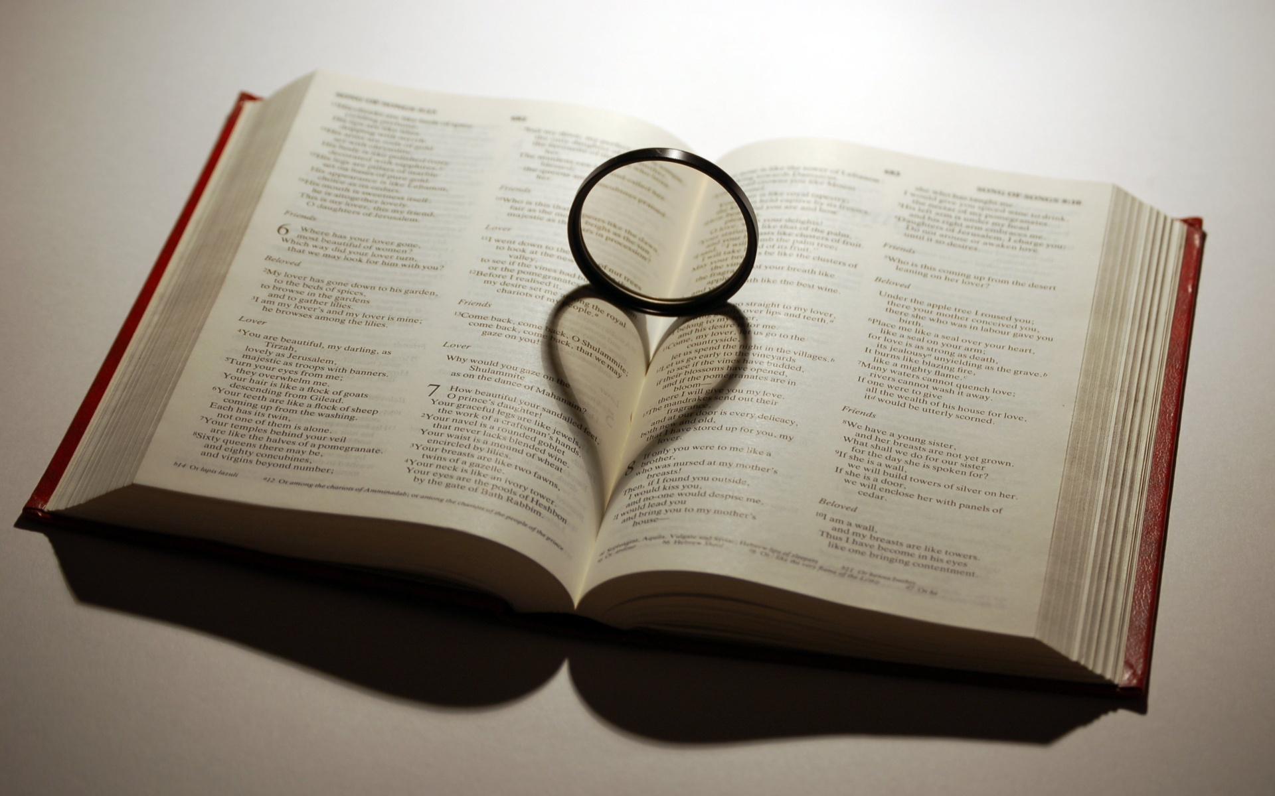
CHRIST THE ROCK CONGREGATION
DIMANCHE 4 OCTOBRE 2026
PASTEUR MARC E SIMEON
LE BRISEMENT DES SERVITEURS DE DIEU
THE BREAKING DOWN OF THE SERVANTS OF GOD

Slide 2
Psaume 66:10-12
10 Car tu nous as éprouvés, ô Dieu! Tu nous as fait passer au creuset comme l'argent.
11 Tu nous as amenés dans le filet, Tu as mis sur nos reins un pesant fardeau,
12 Tu as fait monter des hommes sur nos têtes; Nous avons passé par le feu et par l'eau. Mais tu nous en as tirés pour nous donner l'abondance.

Slide 3
Psalm 66 :10-12
10 For You, O God, have tested us; You have refined us as silver is refined.
11 You brought us into the net; You laid affliction on our backs.
12 You have caused men to ride over our heads; We went through fire and through water; But You brought us out to rich fulfillment.

Slide 4
INTRODUCTION
Modern men have mastered the craft of breaking things down.
Some mountains have been flattened to become superhighways.
Some dense forests have been wiped out to become metropolitan cities.
People have turned some rocky terrains into sand mines.

Slide 5
Monstrous machines have been invented to master the most rigid elements of nature.
We know how to break things down to the smallest particles.
We grind; we burn; we explode; we freeze in our effort to tame our environment.

Slide 6
Although we gravely misuse the dominion that God has given us over the physical world, but we act within the compass of our jurisdiction over the earthly realm.
When we consider the lives of the most prominent servants of God, we see that they all had to go to a breaking down process before they could be useful to God.

Slide 7
When we consider biblical characters like Noah, Job, Abraham, Isaac, Jacob, Joseph, Moses, Joshua, Samuel and David, just to name a few;
We see that they all had to go through the rigid breaking down process in God’s school of formation before they were entrusted the tasks tagged to their destiny.

Slide 8
The Tests of authentication of the true servants of God
In Hebrew 11 we read of some of the trials some of the saints had had to go through to make it to God’s hall of fame.
The kingdom of God is made of tested and refined people.
God continues to use different moldings measures in order to shape us to his will.

Slide 9
Because of the presence of sin in our lives, we naturally resist the molding and reshaping of God in favor for our own will.
Those who are in covenant with God have sacrificed their wills on the altar on the day of conversion.
Getting saved is like coming from the wild; the job of the Holy Spirit is to tame us to behave in the likeness of Jesus Christ.

Slide 10
God has no use for those who refuse to be remade.
He who is unable to sustain the breaking down process of God cannot hope to do effective and lasting works for God.

Slide 11
Pride, envy, arrogance, short circuit, discouragement, jealousy, look warm, faking, self-interest, self-promotion, are the common pitfalls for those who escape the breaking down process of God.

Slide 12
Many eager candidates have failed right in the training camp of God.
There is a staggering number of pastors leaving the ministry in the last few years.

Slide 13
THE BREAKING DOWN PROCESS
Ps 66:10 Car tu nous as éprouvés, ô Dieu! Tu nous as fait passer au creuset comme l'argent.
11 Tu nous as amenés dans le filet, Tu as mis sur nos reins un pesant fardeau,
12 Tu as fait monter des hommes sur nos têtes; Nous avons passé par le feu et par l'eau. Mais tu nous en as tirés pour nous donner l'abondance.

Slide 14
Ps 66:10-12 For You, O God, have tested us; You have refined us as silver is refined.
11 You brought us into the net; You laid affliction on our backs.
12 You have caused men to ride over our heads; We went through fire and through water; But You brought us out to rich fulfillment.

Slide 15
God has no need for soft and fearful soldiers.
God trains his own for the worse case scenarios against the devil.
In Psalm 66 we see that it pleases God to let his saints go through hardships before they experience a breakthrough in life.

Slide 16
That includes the wrongs that you have endured from others.
That includes even the mistakes that you have made.
Sometimes God allows you to make certain mistakes early in life to afford you the exposure of the consequences of sin.

Slide 17
A man destined to be rich may know abject poverty in the morning of his life.
Some of the most successful people have had very humble beginnings.
La 3:26-32 Il est bon d'attendre en silence Le secours de l'Éternel.

Slide 18
27 Il est bon pour l'homme De porter le joug dans sa jeunesse.
28 Il se tiendra solitaire et silencieux, Parce que l'Éternel le lui impose;
29 Il mettra sa bouche dans la poussière, Sans perdre toute espérance;

Slide 19
30 Il présentera la joue à celui qui le frappe, Il se rassasiera d'opprobres.
31 Car le Seigneur Ne rejette pas à toujours.
32 Mais, lorsqu'il afflige, Il a compassion selon sa grande miséricorde;

Slide 20
Moses had to be raised in the palace of the Pharaoh so that he could be exposed to all the mysteries and all the knowledge and the splendor of Egypt.
Moses had to know the depth of sin in order to become the legislator of righteousness.
Joseph had to know what slavery was like before God could elevate him to dignity.

Slide 21
David has had to take many classes and exams from God’s school of formation before being admitted king and guardian of the nation of Israel.
Gideon had to experience an existential meltdown before he could enter to his destiny as a mighty man of valor before God.

Slide 22
Paul had to be so hateful of Christians before becoming the pioneer in the advancement of the gospel.
Before one is fit for God’s service, he must go through the most enduring process.
Your motives, your actions, your thoughts, your emotions must all aligned to God’s will.

Slide 23
You will be tested; you will be tempted; you will be persecuted; and you will have to fight discouragement.
You will have to submit your will to God’s will.
You will have to stand alone at times.
You will have to forgive others again and again, and again.

Slide 24
You will have to tame your flesh and learn to walk uprightly before God.
Without the breaking down of God, there’s no guaranty that one will be able to sustain all that life will be throwing at them in the battlefield.

Slide 25
GOD THE POTTER RESHAPES OUR LIVES FOR SECONDARY PURPOSES WHEN NEEDED
There are times when we fail so miserably to qualify for the task that God had initially planned for us.
Like the potter with the defected clay, God is busy reshaping many of us for a secondary usage.

Slide 26
Jérémie 18:1-6
1 ¶ La parole qui fut adressée à Jérémie de la part de l'Éternel, en ces mots:
2 Lève-toi, et descends dans la maison du potier; Là, je te ferai entendre mes paroles.
3 Je descendis dans la maison du potier, Et voici, il travaillait sur un tour.

Slide 27
4 Le vase qu'il faisait ne réussit pas, Comme il arrive à l'argile dans la main du potier; Il en refit un autre vase, Tel qu'il trouva bon de le faire.
5 Et la parole de l'Éternel me fut adressée, en ces mots:

Slide 28
6 Ne puis-je pas agir envers vous comme ce potier, maison d'Israël? Dit l'Éternel. Voici, comme l'argile est dans la main du potier, Ainsi vous êtes dans ma main, maison d'Israël!
God has both an initial and several secondary plans for everyone’s life.

Slide 29
The initial plan is the highest and the most rewarding plan that God bestowed on a person before his or her birth.
The initial plan of God in one’s life is like the first E.T.A. from a GPS when taking a long trip.
The GPS calculates distances, speed limit, ideal weather, traffic lights and non-stop driving to give you the first estimated time of arrival.

Slide 30
What the GPS cannot control is the actual driving conditions like: detours, unforeseen traffic delays, adverse weather conditions, tiredness, breakdown, fueling, accidents, laziness, construction delay, etc.
As you continue the trip, the ETA keeps on changing.

Slide 31
If you get lost, the GPS writes you another route plan.
If you don’t want to pay tolls, the GPS will write you another route plan.
If you don’t want to use highways, the GPS will write you another route.
Each route plan will affect the ETA.

Slide 32
God places us on earth with an ETA for everything He wished for us to accomplish.
When we fail to reach our destination on God’s estimated time, it is always driver error.
Satan is very active to distract people from the original route plan of God.

Slide 33
Very few in this world are on the original course that God had intended for them.
A litany of other reasons may have caused God the potter to move to plan B with us the clay.
We are not here to discuss yours or my failure.

Slide 34
This room is full of people who are on plan B, or plan C, or plan Z with God.
God the good potter is very creative.
God the good potter has no intention to waste you and me the clay.
There is always another object the good potter can use the clay for.

Slide 35
Ask God to make something out of you. Ask God not throw you away.
You must be very humble at this point. Forget about the original plan.
Accept the fact that you are at fault in God’s having to do all kinds of gymnastics to draft a plan B for your life.

Slide 36
Come to God like the prodigal son returned to his daddy’s house with no sense of merit.
Come to God with a humble attitude while acknowledging your unworthiness for a second consideration.
The secret is the fact that God cannot and will not despise a contrite heart.

Slide 37
Ps 51:17 (51:19) Les sacrifices qui sont agréables à Dieu, c'est un esprit brisé: O Dieu! tu ne dédaignes pas un cœur brisé et contrit.
17 The sacrifices of God are a broken spirit, A broken and a contrite heart-These, O God, You will not despise.

Slide 38
God is a master craftsman; He can make the most eloquent piece of art from broken and rough clays.
God can turn ashes into beauty.
Forget about what you could have been; enjoy what God is making of you now.

Slide 39
CONCLUSION
Whether you are on God’s original plan or in the last plan in the book, be thankful that you are in God’s hands.
Watch out for sin. Watch out for spiritual pride. Watch out for arrogance.

Slide 40
Be thankful, and be humble. Make the best of your second chance.
Make sure to catch all the heavenly rewards you can with the vessel that God makes of you whether original of secondary.
Amen!

