Slide 1

CHRIST THE ROCK CONGREGATION
SUNDAY OCTOBER 31ST 2021
Sermon by Pst. Marc Edouard Simeon
THE WORTH OF THE SOUL OF A HUMAN BEING
LA VALEUR DE L’AME D’UN HUMAIN
Et que sert-il à un homme de gagner tout le monde, s'il perd son âme?
"For what will it profit a man if he gains the whole world, and loses his own soul?

Slide 2
LECTURE : MARC 8 :34-38
34 Puis, ayant appelé la foule avec ses disciples, il leur dit: Si quelqu'un veut venir après moi, qu'il renonce à lui-même, qu'il se charge de sa croix, et qu'il me suive.
35 Car celui qui voudra sauver sa vie la perdra, mais celui qui perdra sa vie à cause de moi et de la bonne nouvelle la sauvera.

Slide 3
36 Et que sert-il à un homme de gagner tout le monde, s'il perd son âme?
37 Que donnerait un homme en échange de son âme?
38 Car quiconque aura honte de moi et de mes paroles au milieu de cette génération adultère et pécheresse, le Fils de l'homme aura aussi honte de lui, quand il viendra dans la gloire de son Père, avec les saints anges.

Slide 4
Mr 8:34 When He had called the people to Himself, with His disciples also, He said to them, "Whoever desires to come after Me, let him deny himself, and take up his cross, and follow Me.
35 "For whoever desires to save his life will lose it, but whoever loses his life for My sake and the gospel's will save it.

Slide 5
36 "For what will it profit a man if he gains the whole world, and loses his own soul?
37 "Or what will a man give in exchange for his soul?
38 "For whoever is ashamed of Me and My words in this adulterous and sinful generation, of him the Son of Man also will be ashamed when He comes in the glory of His Father with the holy angels."

Slide 6
INTRODUCTION
In this materialistic society in which we live, a price is attributed to everything and everyone.
People often talk about the worth of individuals.

Slide 7
Celebrities go a long way to be highly ranked in the list.
This year 2021,The Forbes Magazine listed the 500 richest people living.
I will name a few, look for your name and other notable people.

Slide 8
#1 Jeff Bezos. $177 B. United States. Amazon. Age 67... 2014 # 18 / 32 Billions
#2 Elon Musk. $151 B. United States. Tesla, SpaceX. Age 49
#3 Bernard Arnault & family. $150 B. France. LVMH.72 ...
#4 Bill Gates. $124 B. United States. 65 (Microsoft) ... in 2014 Bill Gate was #1 with a net worth of $76 Billions

Slide 9
Mark Zuckerberg. $97 B. United States. ..facebook 36. In 2014 he was # 21 $28.5 Billions
Warren Buffett. $96 B. United States. ...
Larry Ellison. $93 B. United States. ...
Larry Page. $91.5 B. United States.

Slide 10
#16 Carlos Slim Helu (Mexico) 62.8B Telecom in 2014 # 2 net worth $ 72 Billions
#17 Alice Walton 61.8 Walmart 71yo
#18 Jim Walton 60.2B age 72 Walmart
#19 Rob Walton 59.5B Walmart

Slide 11
WORTH
Worth is everything in this world
People who are less fortunate are considered worthless.
Though we say that all men are created equal (like said in the Animal Farm (cartoon): Some animals are created more equals than others.

Slide 12
Likewise human beings think of themselves in the fashion that some people are created more equal than others.
Your color
Your family name
Your education
Your beauty

Slide 13
Your popularity
Your circle of acquaintances
Your intelligence
Your background
The circumstances of your life all play a part to determine your worth in this world.

Slide 14
In Mark 8: 36 and 37 Jesus asked two striking and thought provoking questions that change everything.
Jesus is suggesting that there is something that has more value that money, silver and gold. Something that all the combined wealth of the universe cannot afford.

Slide 15
Let us examine these verses now.
Mr 8:36 "For what will it profit a man if he gains the whole world, and loses his own soul? 37 "Or what will a man give in exchange for his soul?
Mr 8:36 Et que sert-il à un homme de gagner tout le monde, s'il perd son âme? 37 Que donnerait un homme en échange de son âme?

Slide 16
THE SOUL OF MAN
First, “What Is The Soul?”
Second, “What Is The Worth of The Soul?
And third, “What Does It Mean For One To Lose His Soul?
We see the term “soul” many times in the Holy Scriptures.

Slide 17
In Matthew 10:28 "And do not fear those who kill the body but cannot kill the soul. But rather fear Him who is able to destroy both soul and body in hell. (NKJV)
28 Ne craignez pas ceux qui tuent le corps et qui ne peuvent tuer l'âme; craignez plutôt celui qui peut faire périr l'âme et le corps dans la géhenne. (LSV)

Slide 18
The “soul” is the seat of our human WILL. Your character,, your intellect, your thoughts, your emotions are all found in our soul.
The soul is where we reason, where we decide, where we choose.

Slide 19
The soul is what makes us conscious of ourselves.
In short, your soul is the very essence of the very essence of your LIFE as a human being here on earth.
Your soul is what distinguishes you and makes you uniquely different from anyone else.

Slide 20
THE SPIRIT OF MAN
The “spirit” on the other hand is that part of us that makes us conscious of GOD.
Everyone born into this world is dead spiritually.
EPHESIANS 2:1 says, And you He made alive, who were dead in trespasses and sins, (NKJV)

Slide 21
Eph 2:1 ¶ Vous étiez morts par vos offenses et par vos péchés, (LSV)
Until the Holy Spirit “quickens” or “awakens” “our spirit we remain dead spiritually.
Our spirit is that part of us that yearns for God and desires to be near to God and to worship God.

Slide 22
Well let's move on to our second question..........
II. WHAT IS THE WORTH OF THE SOUL?
THE WORTH OF THE HUMAN BODY
Someone had calculated the worth of the human body and found that the human body is comprised of
65% oxygen, 18% carbon10% hydrogen,
3% nitrogen and about sixteen other elements.

Slide 23
The going rate for “one body's worth” of all those elements together is about a few dollars.
In other words, our physical bodies are worth less you could ever imagine.

Slide 24
THE VALUE WE PLACE IN THE HUMAN BODY
Americans spent $10 BILLION a year on cosmetic surgeries.
$18 BILLION on make-up....
$38 BILLION on hair-care products and
$15 BILLION on perfume.

Slide 25
Think about it! We spent all these billions of dollars to maintain our cheap bodies.
One day our physical bodies will die, but our SOUL will live on!

Slide 26
THE VALUE OF THE HUMAN SOUL
While our physical bodies may not have much “monetary worth” the worth of our soul is PRICELESS the worth of our soul is PRICELESS.

Slide 27
Remember what Jesus said in our text?
Mark 8:36-37 (NKJV)
36 For what will it profit a man if he gains the whole world, and loses his own world, and loses his own soul? 37 Or what will a man give in exchange for his soul? Or what will a man give in exchange for his soul?

Slide 28
Mr 8:36 Et que sert-il à un homme de gagner tout le monde, s'il perd son âme?
37 Que donnerait un homme en échange de son âme?

Slide 29
THE WORTH OF AN OYSTER
Someone wrote:
If you were to ask an oyster about its worth, and it would answer very little.
I am the slowest, I don’t have tails to swim, I don’t even the shape of a real fish. Sand gets easily caught in my shell, every inhabitant of the sea and outside prey on me for food.

Slide 30
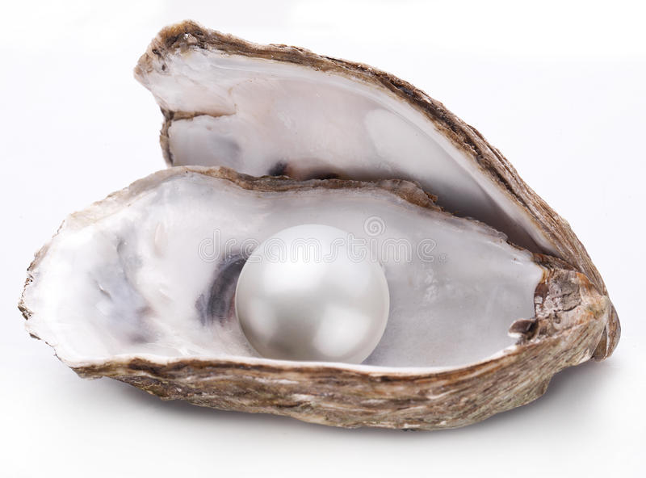
OYSTER / huître French

Slide 31
If you say to the oyster, why them do people do such deep dives in search for you? and it will answer: I don’t know, I just don’t get it!
Little oyster you are more worth than the big sharks, than the colorful fishes, than the electric heels. Why is that? would reply the oyster.

Slide 32
Because of the pearl you produce. What pearl? I just have to keep waxing the blazed grain of sand that gets into me to alleviate my irritation.
The thing that you do with that sand becomes your net worth little oyster.
Queens and kings line-up to behold your masterpiece with great admiration.

Slide 33
People make the most articulate necklaces and Jewels with your pearls.
The oyster would say, I guess you’re right about me being worthy since people are willing to pay so much for my pearl, and the pearl and I are one.
Therefore the worth of my pearl is also my worth.

Slide 34
WHAT TO GIVE IN EXCHANGE FOR THE SOUL
In Mark 8:37 Jesus uses the word “exchange”, a term used to describe a business transaction.
To exchange is to give something in aim of receiving something of equal value. (a fair exchange value).

Slide 35
Nowadays we use money currencies to attach value to something.
Previously (Rice for beans), (potatoes for bananas)
There is NOTHING in this world we could use to buy or trade for our soul.
NOT all the money in the world! NOT all the gold and silver.

Slide 36
NOT all the material things of this world! NOTHING!
WHAT GIVES VALUE TO MAN’S SOUL IS HOW IT WAS CONSTRUCTED AND HOW MUCH IT COST GOD TO REDEEM IT.

Slide 37
THE VALUABLE ANTIQUE
If you were to buy an antique at a yard sale for a dollar and take it to an auction, the minute the auctioneer sees it, he starts acting hysterically.
He calls some of his bodies to marvel at your antique.

Slide 38
Let’s say the opening bid starts at 10 dollars. Within a minutes it goes to 100, a minute later 1000, a minutes later 10000, a minute later 100, 000, a minute later 1 million, 10 million, 1 billion. What would go to your mind?
Now, It gets too late and the bidders are fighting over it.

Slide 39
Then, suppose the auctioneer asks you to bring your object back the following week?
What would you do in the meantime?
How now would you guard it?
How now would you treat it?
Would you still want to sell it?
Would you research about it?

Slide 40
Would you begin to see yourself as a rich person?
Now, suppose that the news has gotten out, and you found out that people will be travelling from all over the world to come to the auction next week in aim to buy your antique.

Slide 41
Now what? Think how complex and perplex and exhilarating your life would become in a short time by the revelation of owning something of great value.
Think of that peace of antique as your very own soul, the only one of a kind, no duplication. That’s your entire universe.
How now do you treat your soul?

Slide 42
CONCLUSION
Think of your soul as your greatest possession because of its eternal nature.
How have you secured the destiny of your soul?
To lose one’s soul is to miss the opportunity to go to heaven.

Slide 43
To lose one’s soul is to subject the soul to eternal suffering.
To lose one’s soul is to be separated from God who is the essence of our existence.
To lose one’s soul is to deprive the soul from happiness and joy and freedom.

Slide 44
To gain the soul is to make the right choice that will benefit the destiny of the soul.
What will it profit a man to exchange the soul for something of a lesser value be it the whole world?
Looking at the way you live your life, can you honestly say that you love your souls?

Slide 45
What have done lately solely for the benefit of your soul?
May God help all of us not to gamble our souls in exchange for the futilitues of this world!
AMEN!

